Slide 1
Opening Doors: Asset-based Approach to Parallel Planning
Cathy Manley
Student Success Coordinator
College of Applied Human Sciences
email: cathy.manley@mail.wvu.edu

Slide 2
Rationale
Expand knowledge of healthcare careers
Focus on students’ goals, interests, and strengths
Prepare students for multiple career paths
Focus on students’ assets rather than
waiting for students to need a “backup plan”

Slide 3
Contact Points
New Student Orientation
First-year Seminar
Semester Advising Appointments
Ongoing

Slide 4
Contact Points
New Student Orientation
First-year Seminar
Semester Advising Appointments
Ongoing
Prior to meeting
Examine high school transcripts
Look for strengths and interests
During the meeting – Ask lots of questions!
What were you involved in during high school?
What attracted you to this major?
What careers have you considered?
What is it about the career(s) that interests you?

Slide 5
Contact Points
New Student Orientation
First-year Seminar
Semester Advising Appointments
Ongoing
Course sections
Assigned by major
Taught by students’ academic advisors
Self-Discovery Activities
CliftonStrengths®
Focus 2
Career Planning Portfolio
Multiple opportunities for self-reflection

Slide 6
Contact Points
New Student Orientation
First-year Seminar
Semester Advising Appointments
Ongoing
Meet at least 1 time per semester
DISCOVER
What is your favorite course? Why?
What activities have you checked out?
DREAM
Discuss current career goals
Discuss similar career paths
DESIGN
Co-construct an individualized plan of study

Slide 7
Contact Points
Experiential Learning Courses
Career Exploration (sophomore)
Job Shadowing (junior)
Internship (senior)
Elective Pre-internship
Student Success Coaches
Student Organization
Q&A career panels
Social events
Weekly Newsletter
Career Spotlight
New Student Orientation
First-year Seminar
Semester Advising Appointments
Ongoing

Slide 8
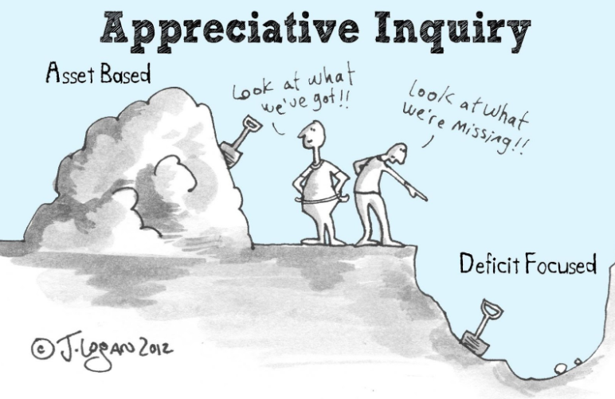
Takeaway
Asset Based
Deficit Focused
Strengths-driven
Needs-driven
Opportunities focus
Problems focus
What is present that we can build upon?
What is missing that we must go find?
Which strengths might you use to overcome obstacles?
Which intervention(s) might we use to correct deficits?

