Slide 1
Advisor Wellbeing: The power of community in the workplace
Robyn Stafford, Student Service Specialist & Advisor Well-being AND Teambuilding Committee Chair
Sarah Davis, Director of Undergraduate Academic Advising

Slide 2
Agenda
Understand the importance of advisor well-being and the influence of community
Review practical strategies for building advisor community
Apply actionable steps for implementation

Slide 3
The power of community: Outcomes

Slide 4
Administrative POV
Impact on Student Success: Advisors who feel supported and well-connected are more likely to bring that positive energy into their student interactions, directly benefiting student engagement, persistence, and success.
Increased Productivity: Advisors who are well-rested, feel valued, and have strong peer relationships tend to be more focused and productive, which ultimately enhances the efficiency of advising services.
Resilience in Times of Change: A strong community helps advisors adapt to changes, whether they be institutional shifts, policy updates, or challenging times like the pandemic. Building trust and camaraderie provides a support system to navigate these changes together.
Work-Life Balance: Prioritizing well-being sends a message that work-life balance is valued, which can encourage healthier habits that advisors carry into both their personal and professional lives.
Cultural Shift Towards Wellness: Regularly integrating well-being into the workplace creates a culture where mental health and wellness are normalized and prioritized, encouraging advisors to care for themselves and one another.
Inspiration and Motivation: Community-building events can reignite passion for the work, helping advisors feel motivated and inspired by the shared mission of serving students.
Leadership Development: Well-being and team-building initiatives give advisors opportunities to take on leadership roles in planning or leading events, helping them grow their leadership skills while contributing to the community.

Slide 5
Advisor POV
Enhanced Communication: Fostering open dialogue and better understanding across teams, leading to fewer miscommunications and smoother collaboration.
Improved Morale: Giving advisors a chance to bond outside of their typical work routine can boost morale and overall job satisfaction.
Stress Reduction: Well-being events provide opportunities to relax and destress, which can reduce burnout and improve mental health.
Increased Collaboration: Creating an environment where advisors feel comfortable reaching out for support and sharing ideas.
Professional Growth: Encouraging continuous learning and improvement through shared experiences, which can inspire creativity and innovation.
Sense of Belonging: Fostering inclusivity and helping advisors feel more connected to the institution and each other.
Retention: Increasing job satisfaction can positively impact advisor retention rates by creating a more supportive and engaging work environment.
Creative Outlet: This allows an opportunity to engage creatively and provide an outlet when our work is emotionally taxing.

Slide 6
practical strategies for building advisor community

Slide 7
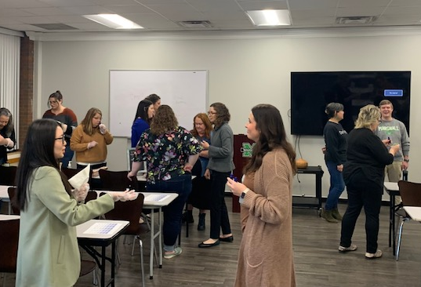
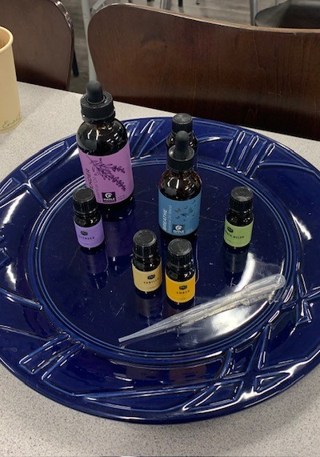
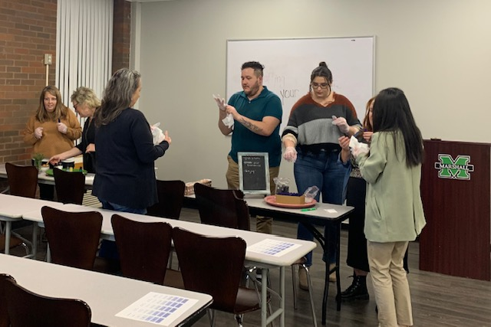
Advisor Wellbeing Event - Crafting Your Essential Balance: Essential Oil Event

Slide 8
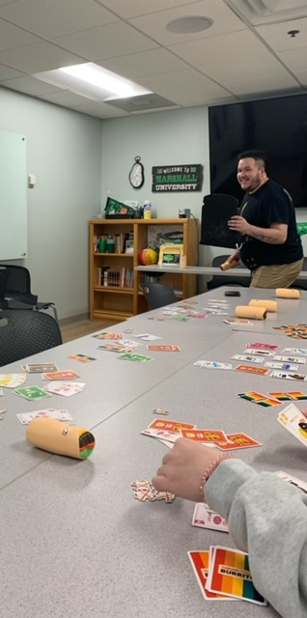
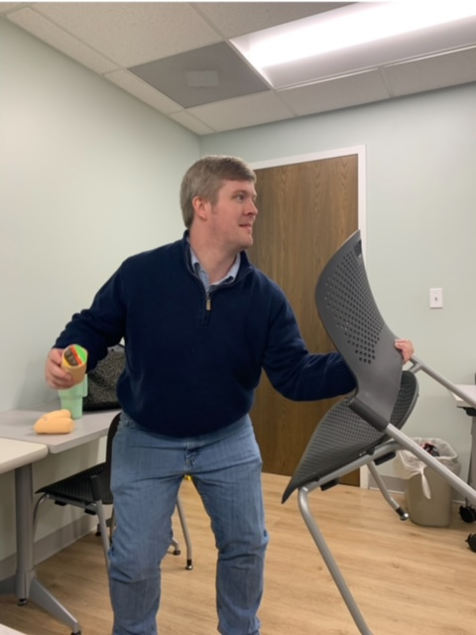
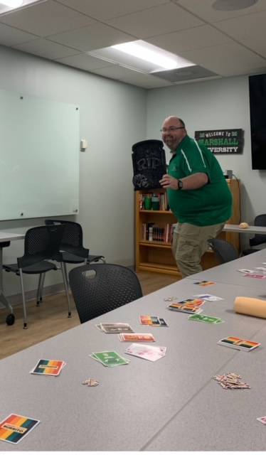
Game Guild Event - Throw, Throw Burrito

Slide 9
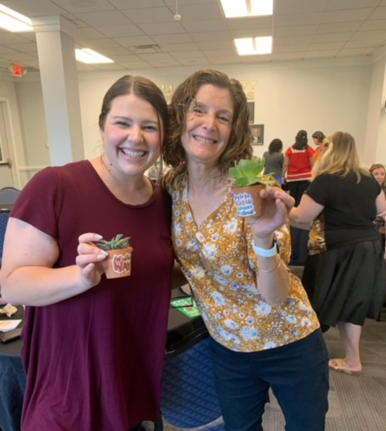
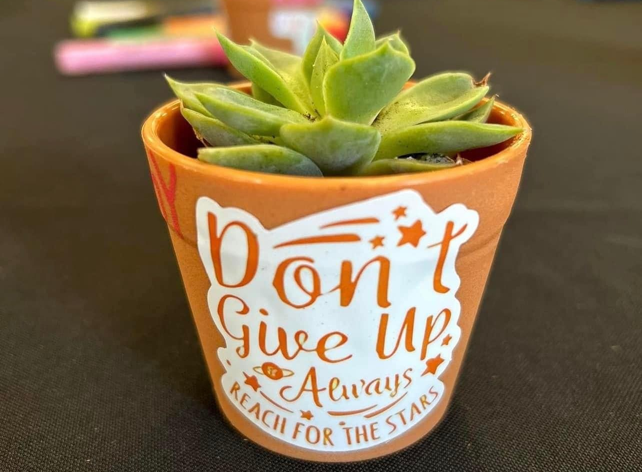
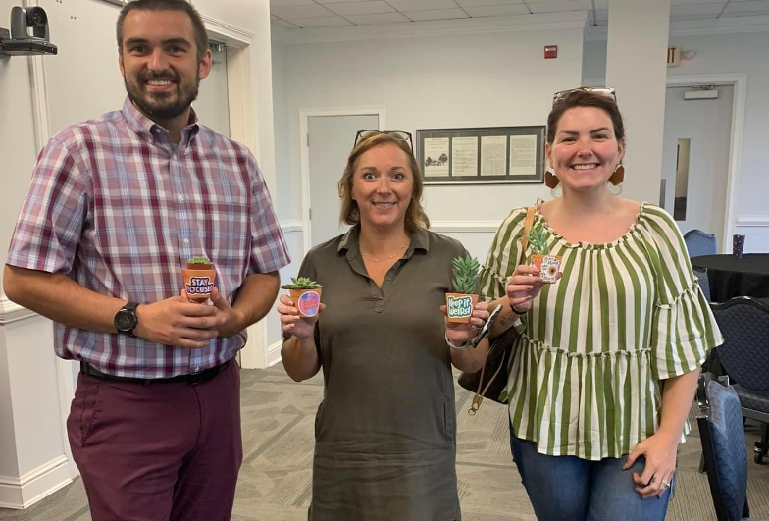
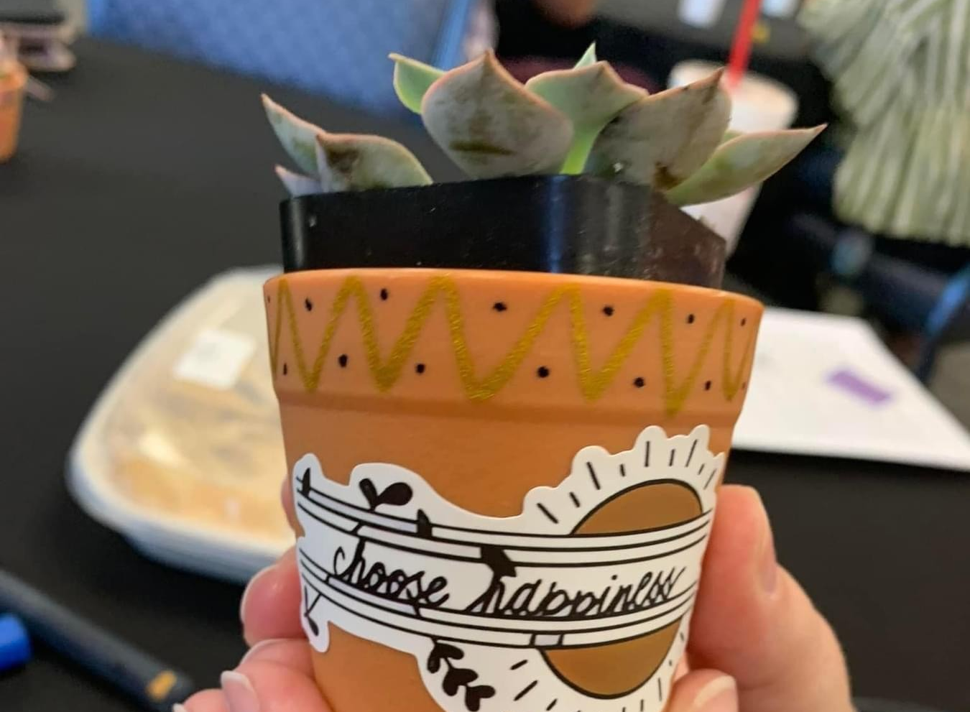
Advisor Wellbeing Event - Rooted in Resilience:
Succulent Planting and Painting

Slide 10
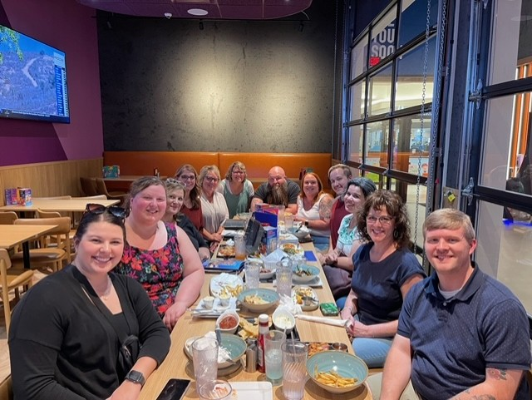
Advisor Team Building Event -Dave and Busters Advisor Night!

Slide 11
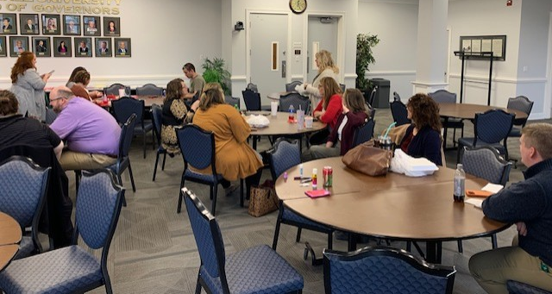
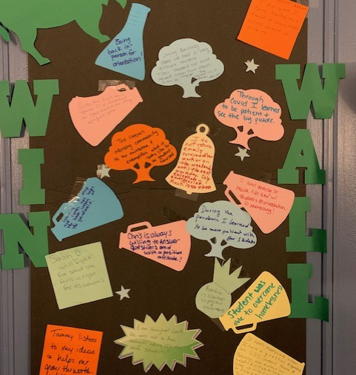
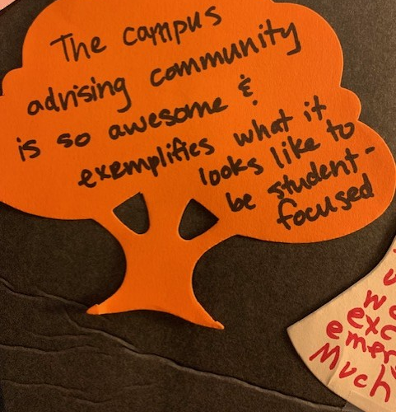
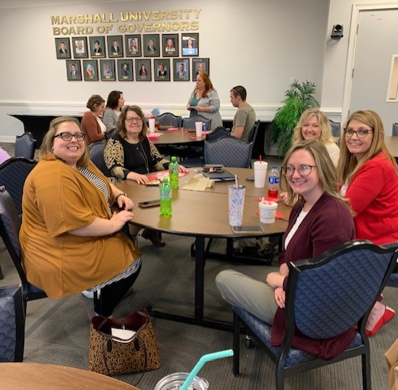
Advisor Retreat 2021 & 2022

Slide 12
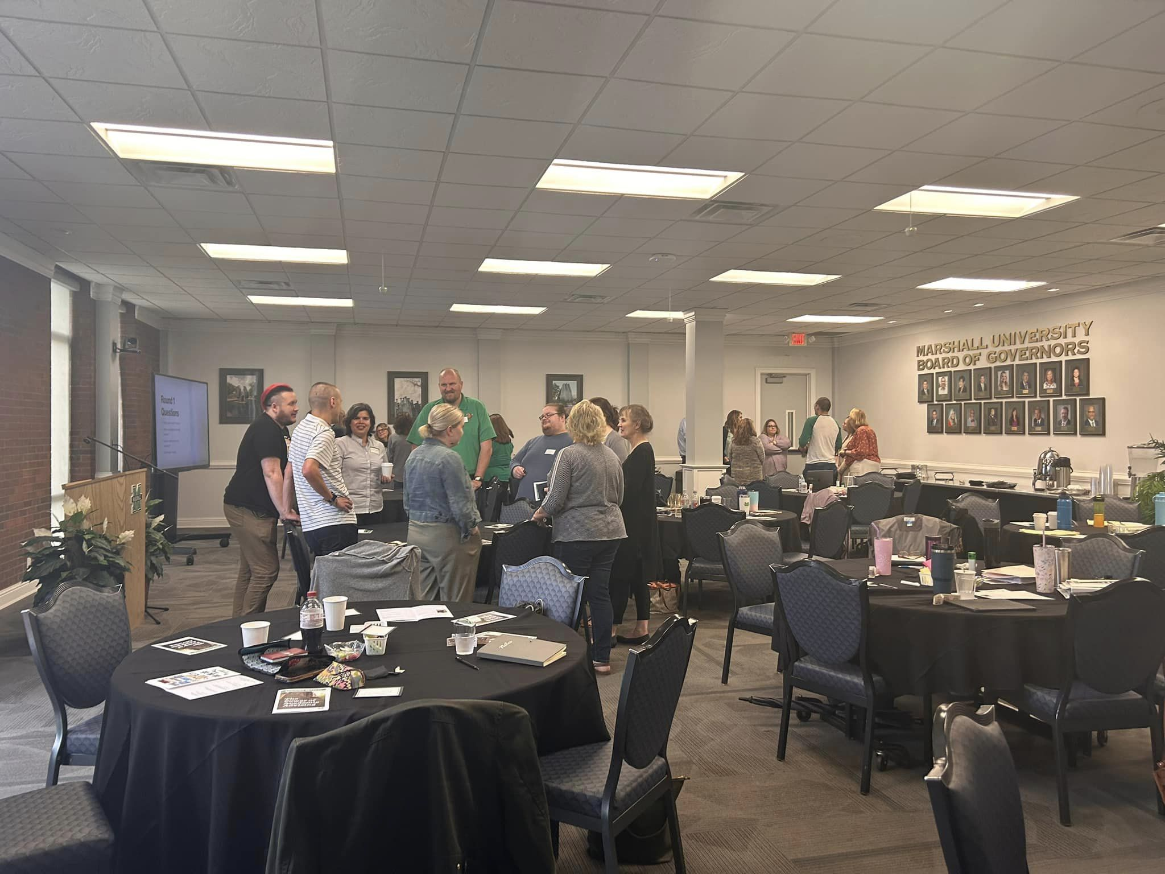
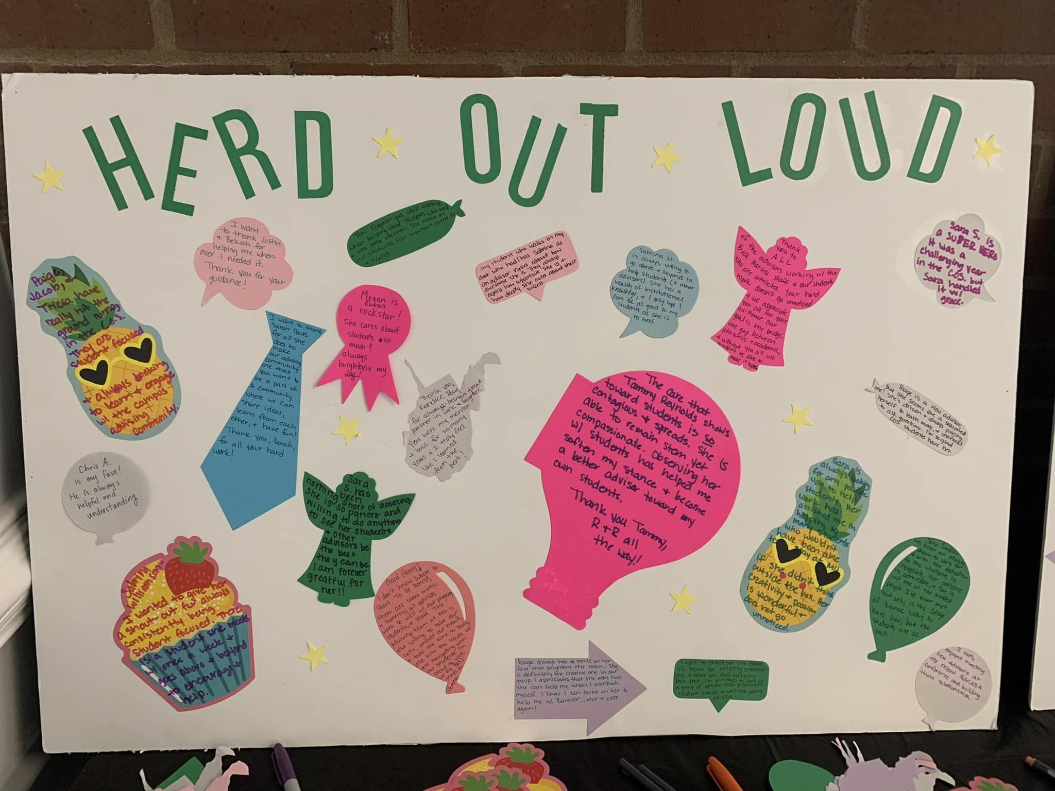
Advisor Retreat 2023

Slide 13
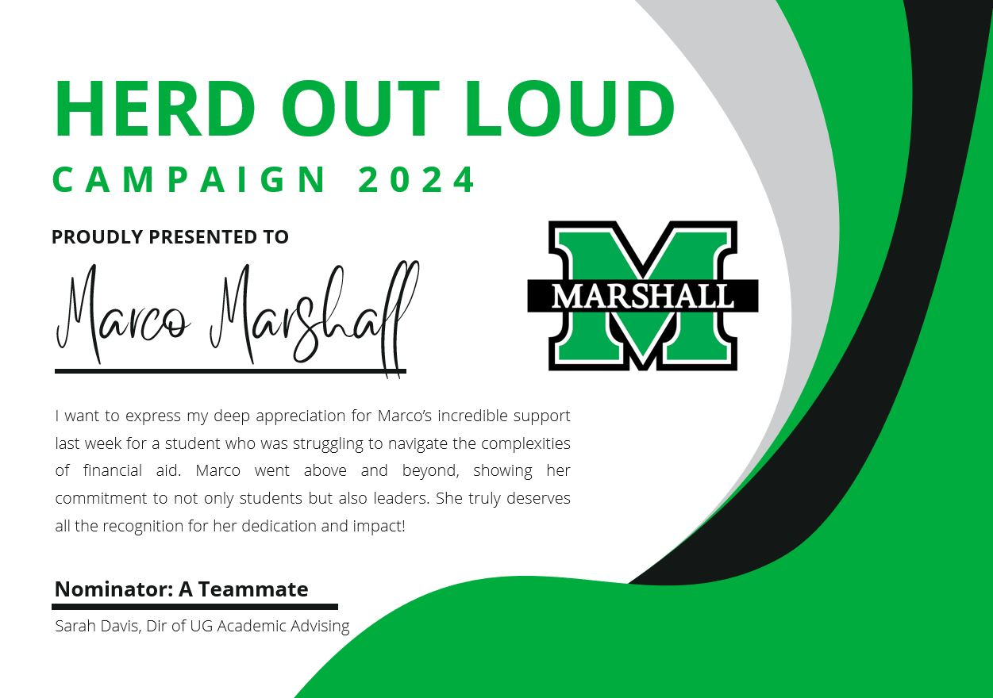
Advisor Retreat 2024 – Launched Electronic Herd Out Loud Campaign

Slide 14
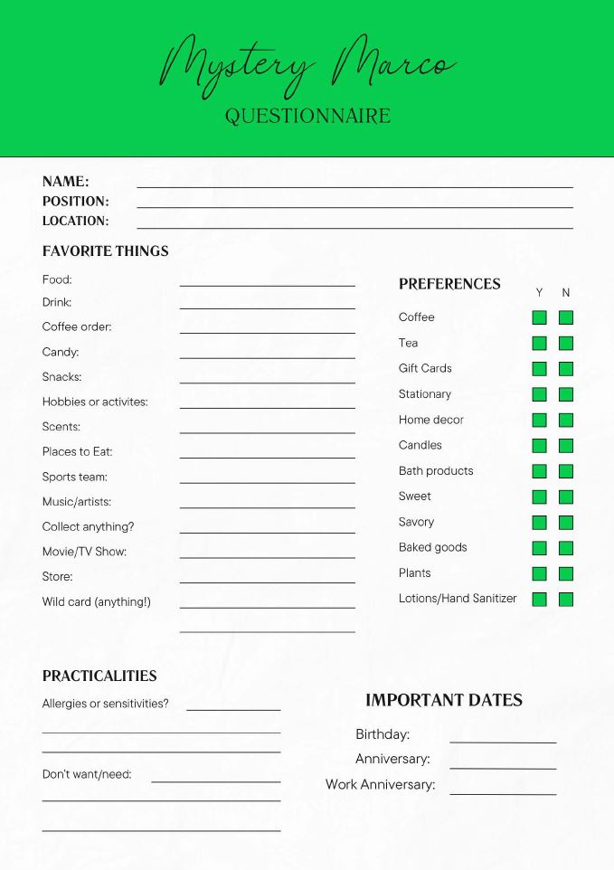
Mystery Marco Launched Fall 2024 – Led by Staff Member

Slide 15
actionable steps for implementation

Slide 16
Build Community on Your Campus
Select Strong Leadership and Support
Identify a passionate and organized leader to spearhead your well-being and team-building efforts. Build a dedicated team around them to ensure diverse ideas and seamless execution.
Market with Creativity and Care
Promote your events with engaging, fun, and inclusive marketing. Use eye-catching visuals and compelling messaging that sparks excitement and encourages participation.
Launch, Learn, and Leverage
Execute your events, assess their impact, and gather feedback. Continuously refine your approach to maximize engagement and foster a lasting sense of community.

Slide 17
THANK YOU
Robyn Stafford,
messeng1@marshall.edu
Sarah Davis,
sarah.davis@marshall.edu

