Slide 1
Responsive Dashboard vs Classic Dashboard
Office of the University Registrar at West Virginia University
January 2024

Slide 2
Background and Introduction
In the 5.0.2 upgrade of Degree Works, the Responsive Dashboard was released by Ellucian to modernize the experience for students and advisors.
The Responsive Dashboard has a more intuitive interface making it a mobile friendly tool that was ADA compliant.
Ellucian has been supporting both versions (Responsive and Classic) to allow users to make the transition to the Responsive Dashboard.
WVU is required to upgrade to version 5.1.3 this year. With this version, Ellucian no longer supports the Classic Dashboard. Information for both dashboards pull from Banner.

Slide 3
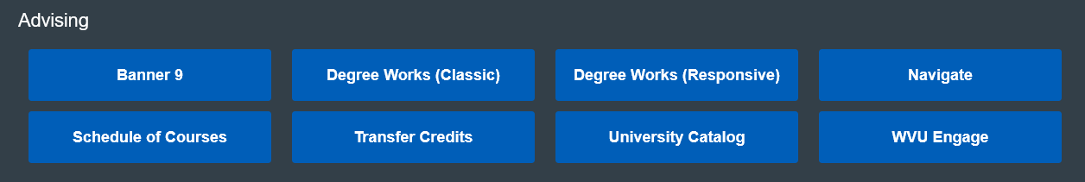
What will change?
Beginning mid-July 2025, the Classic version of Degree Works will no longer be available.

Slide 4
Copy of Email notification sent to WVU Faculty and Instructions, AA Deans, AAC listserv, and Students in February 2022:
New, mobile-friendly Degree Works button will appear in the Portal on Monday, Feb. 7
Students, faculty and advisors will see a new, mobile-friendly option for launching Degree Works from the WVU Portal on Monday, Feb. 7 with a button labeled Responsive.” That means the application will automatically resize for mobile devices, making it easier to read content and navigate on smaller screens.
You will see the same, current data from Banner/STAR, regardless of which button you select. Updates made using either Degree Works option will automatically be reflected in both dashboards.
The new intuitive platform will feature an updated plan of study function. It will be easier for you to build the course plans for your students by simply dragging and dropping the selected courses into the pre-built columns. The addition of collapsible blocks will make it easier to hide information that you don’t immediately need or want.
However, some external links will no longer be available such as the Graduation Applications, Financial Aid and Subject History. Ellucian, the vendor behind Degree Works, is requiring this change with this system update. Removing customized features may help reduce the risks of broken links after future Ellucian upgrades. The Registrar’s Office is exploring other ways to make this information available.
The old Degree Works button, labeled “Classic,” will remain available through at least the end of the Spring 2023 semester to allow time for adjusting to the new platform.
You can register for a Degree Works training session or view additional informational documents at the Registrar’s website: https://registrar.wvu.edu/resources-and-training/banner-degreeworks-training
Please direct any questions to Registrar@mail.wvu.edu.

Slide 5
Comparisons for Review
Homepage
Find/Search
Student Header/Summary Data
Printing
Subject History
GPA Calculator, Class History, Notes
Contacts and Emails
Historical Audits
Audit Views and Details
External Links
Adding Exceptions
Plans
Refresh and Process New
Contact Information
What-If
Collapsing Blocks
Legend
Removing Exceptions

Slide 6
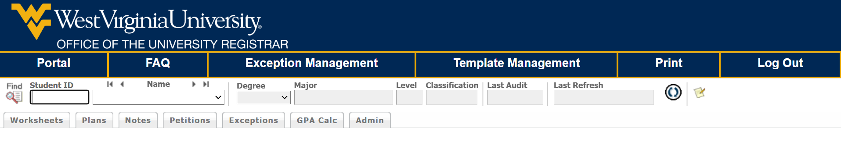
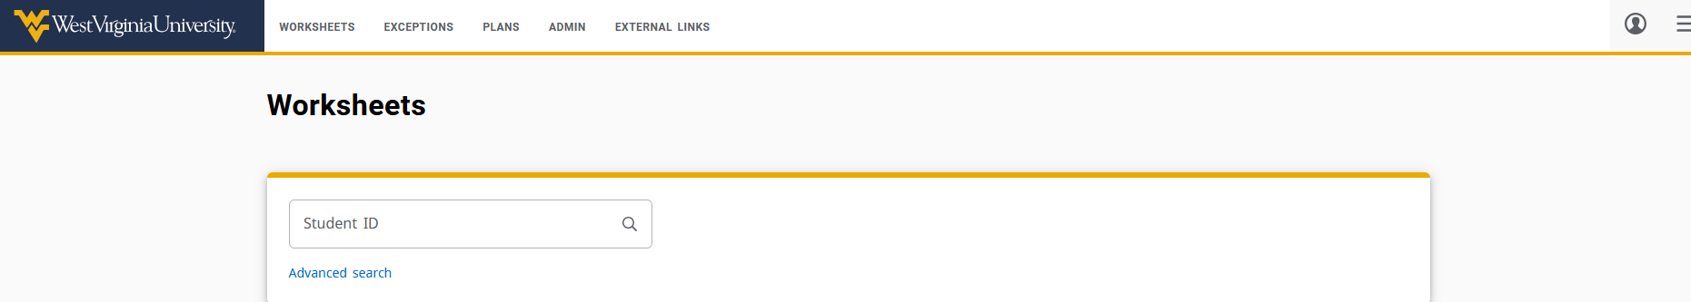
Homepage
Classic
Responsive

Slide 7

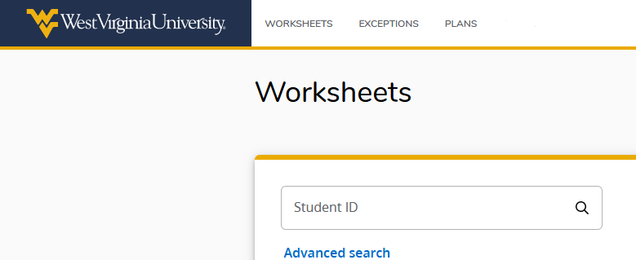
Responsive Homepage
The Responsive Dashboard homepage contains a simple student search, as well as the pop-up menu for the Advanced Search.
The Worksheet, Exceptions, and Plans tabs are persistent across all pages of the Responsive Dashboard.

Slide 8
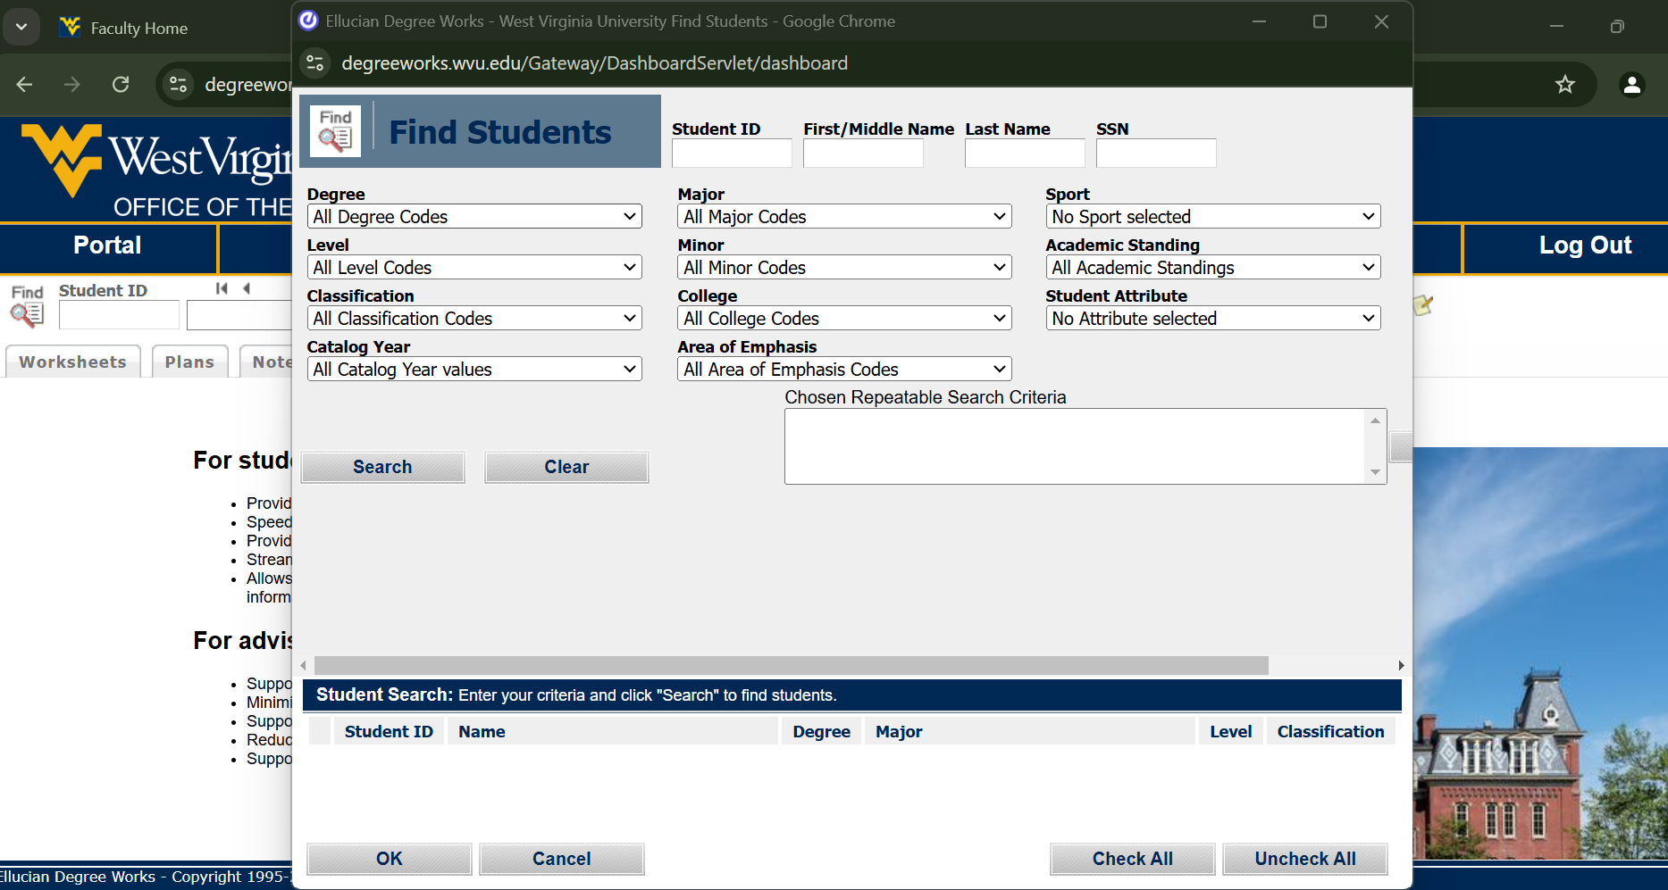
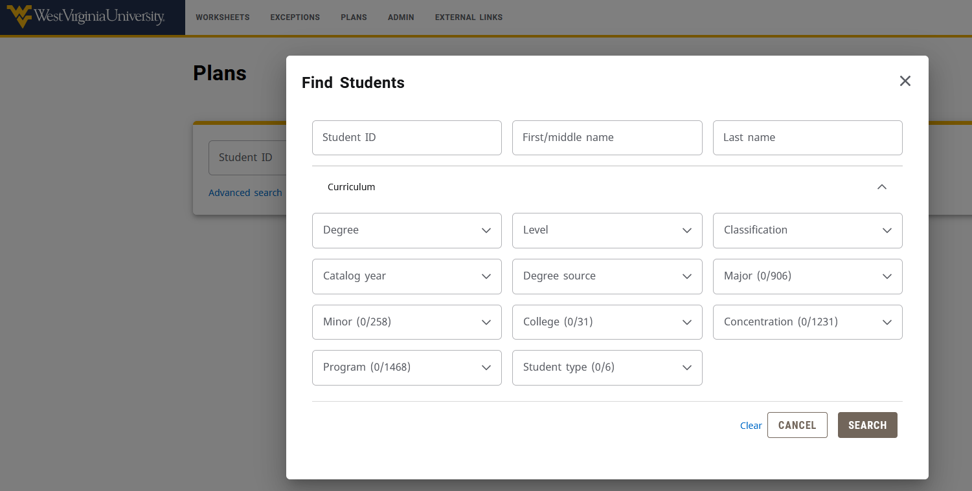
Find and Search
The Classic ‘Find’ is now the Responsive ‘Advanced Search’ Link located below the Student ID field. The Classic and Responsive Search Menus appear different but contain much of the same information.
Classic Dashboard
Responsive Dashboard

Slide 9
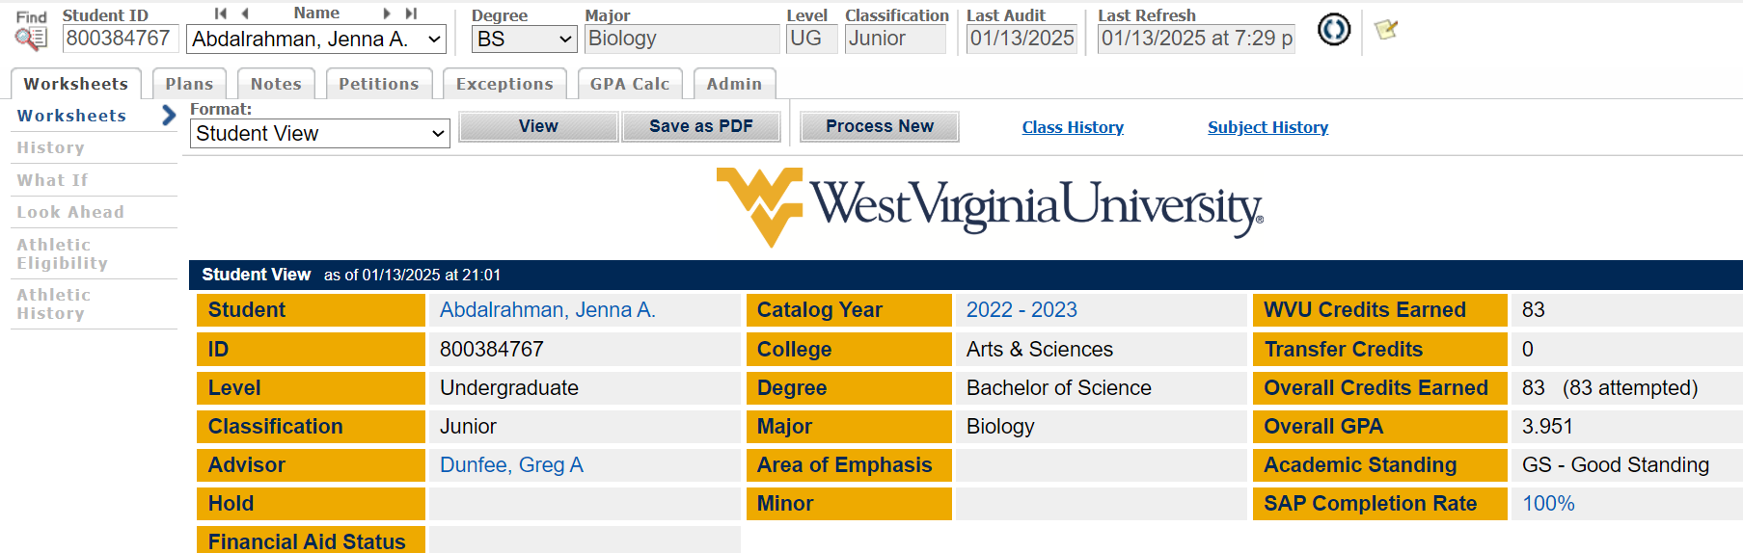

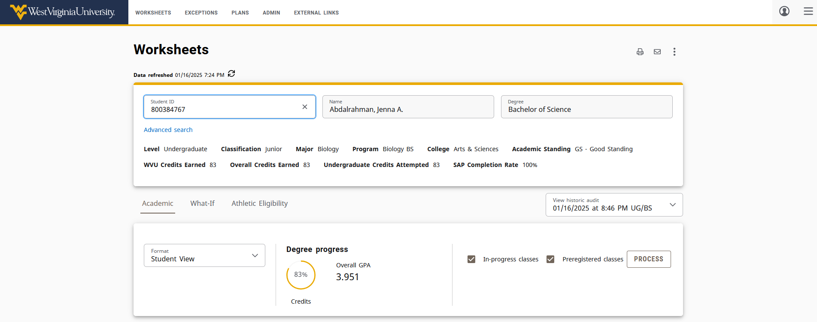
Student Header/Summary Data
Classic Dashboard
Responsive Dashboard
Main differences
Where and how the information appears
Headers only appears if information is listed on student’s record (e.g. if student doesn’t have a minor list, the Minor header won’t appear in the box)
Hyperlinks aren’t available in the header, only under external links and mail icon
Catalog Year replaced with external link to current catalog, will need to select archived catalogs to look at previous years

Slide 10
Student Header/Summary Data
The Responsive Dashboard’s header includes only the information pertinent for each student
Items that appear if listed on a student’s record:
Academic Standing
Holds
Transfer Credits
Area of Emphasis
Minors
Applied for Graduation
Items appearing on most audits:
Level
Classification
Major
Program
College
WVU Credits Earned
Overall Credits Earned
Credits Attempted
Overall GPA
SAP Completion Rate

Slide 11
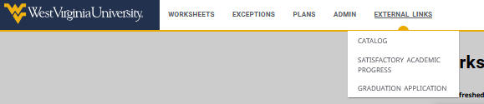
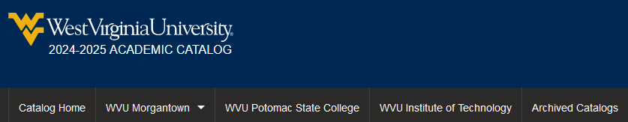
Student Header/Summary Data
External Links
The External Links includes links to the University Catalog, SAP information and the Graduation Application in STAR.
The University Catalog includes Archived Catalogs to select and view previous catalog years

Slide 12
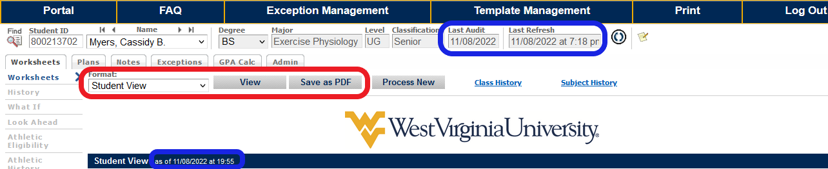
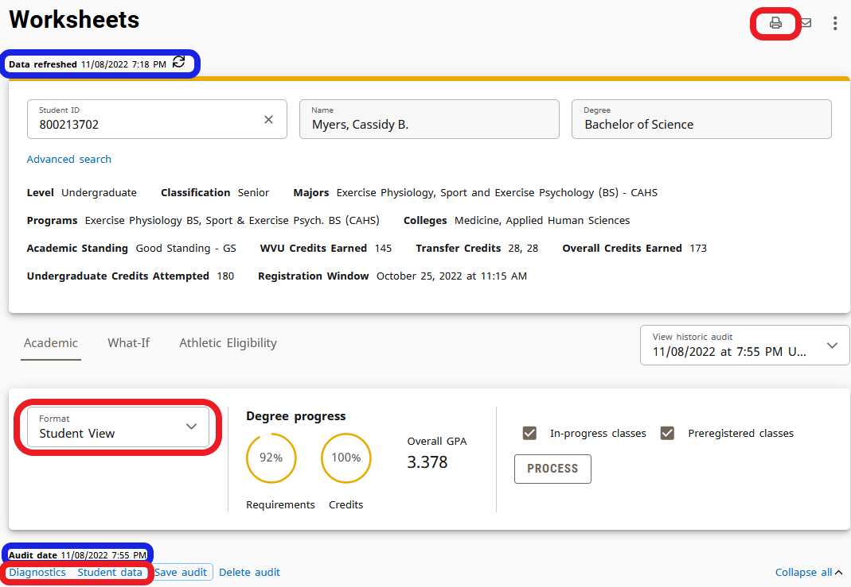
Audit Views and Details
Classic Dashboard
Responsive Dashboard
The views have been organized into a ‘Format’ drop-down box in the audit section and into links below the block. ‘Save as PDF’ has been moved to the top right of the audit represented by the printer icon.

Slide 13
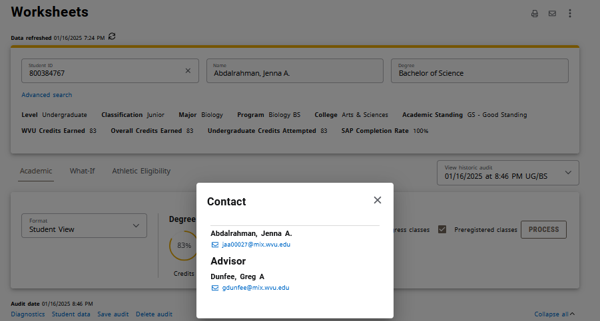
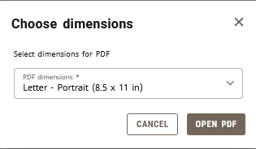
Print Function
Selecting the printer enables the audit to be opened in PDF format
Student Name
Hyperlink to student’s email
Advisor Name
Hyperlink to advisor’s email

Slide 14
Contacts/Emails
The envelope icon shows the names and email links for the student and advisor
Student Name
Hyperlink to student’s email
Advisor Name
Hyperlink to advisor’s email

Slide 15
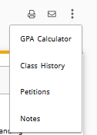
GPA Calculator, Class History, Petitions, Notes
The Three Vertical Dots will bring up options for
GPA Calculator
Class History
Petitions
Notes
Student Name
Hyperlink to student’s email
Advisor Name
Hyperlink to advisor’s email

Slide 16

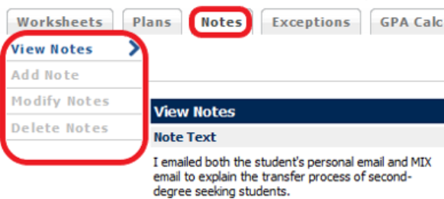
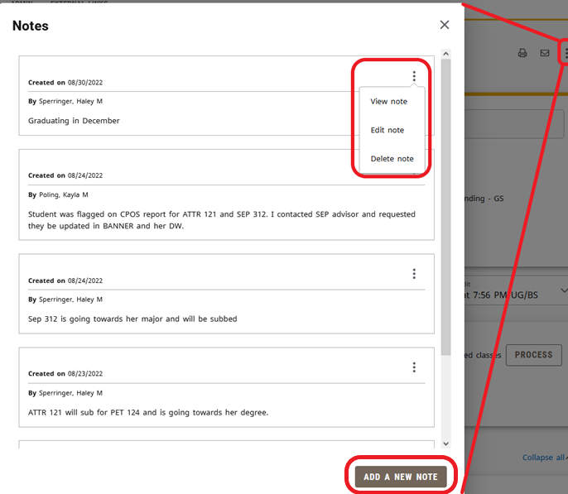
Notes
Classic Dashboard
Responsive Dashboard
Same features exist, but the left-side menu has been moved to a kebab menu listed for each existing note while a separate ‘Add a New Note’ button features prominently at the bottom.

Slide 17
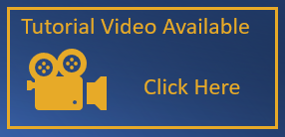
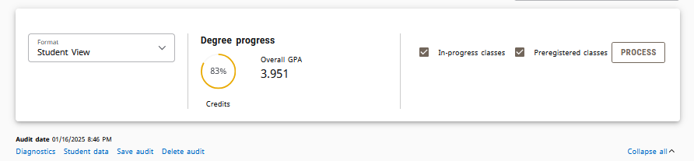
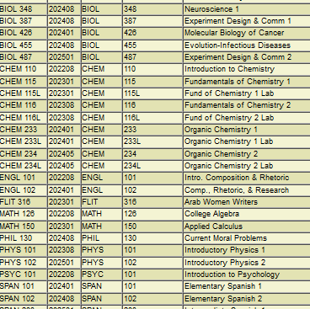
Subject History
The “Student data” link contains in the “Class-Dtl” section contains all courses listed alphabetically by course and numberically by course number. The table includes comprehensive information related to the course such as CRN, level, and grade.
Other information can be discerned on this page as well, such as curricula codes, test information, course attributes, and transfer course details.
In the Classic Dashboard, the Subject was created inhouse specifically for WVU.
In the Responsive Dashboard, the “Student data” link is one tool that can be used to replace it.

Slide 18
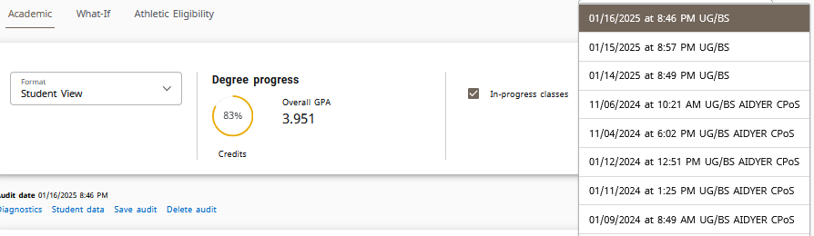
Historical Audits
Selecting View historic audit enables users to review audits from a specific point in time.

Slide 19
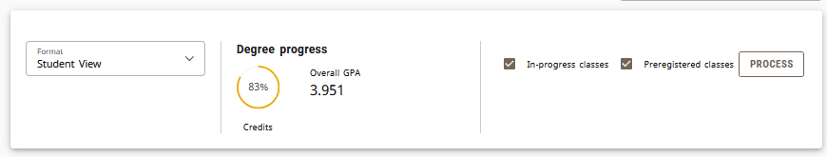
Refresh and Process New
Data refreshed icon pulls updated data from the Student Information System (SIS)
Refresh this student’s data from your student system
Process button refreshes the data in Degree Works.

Slide 20

Collapsing Blocks
The Header of each block displays the same information as seen in the Classic Dashboard.
One new function of the Responsive Dashboard is the ability to collapse blocks. Click the arrow in the top right corner of the block to collapse or reveal the block contents.

Slide 21

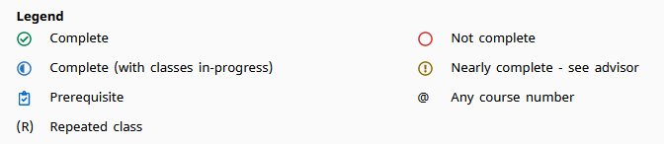
Legend
Classic Dashboard
Classic Dashboard
Responsive Dashboard

Slide 22
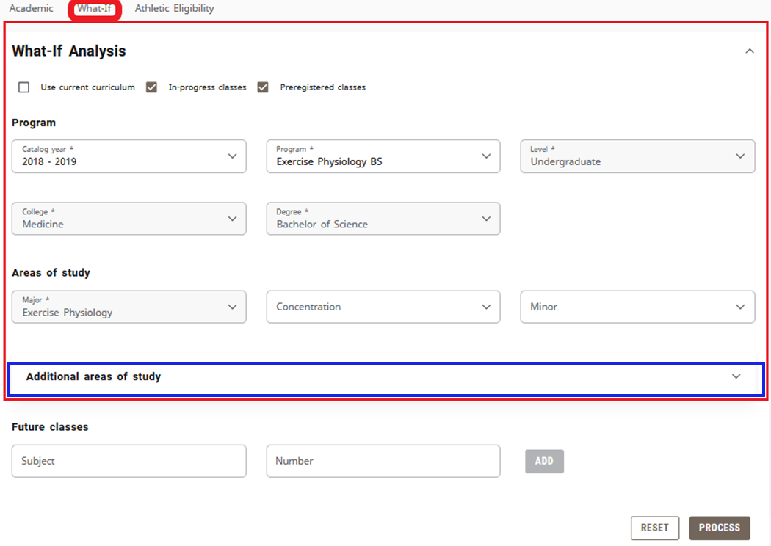
What-If
The What-If Feature is located directly under the Student Header block
The What-If allows students and advisors to simulate how a student's audit will appear if they were to change their
major, or add an additional credential, such as a Minor or Area of Emphasis.
The “Look Ahead” feature in the Classic Dashboard has been combined with the What-if in the Responsive Dashboard, and has been labeled as “Future Classes”

Slide 23
Major Change What-If
To perform a simulated major change on a student, select a catalog year and program from the drop down menu.
If the student has any minor(s) or concentrations those can be added optionally.
Once the information has been entered, click the ‘Process’ button at the bottom of the page.

Slide 24
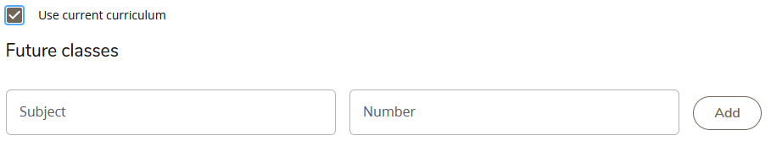
Future Coursework What-If
If a student is not interested in changing their major, but instead wants to know how a future course may affect their audit, the Responsive Dashboard can do that.
By checking the ‘Use Current Curriculum’ button, a student can enter a Subject and Course Number. The What-If will
take the courses entered and place them into the appropriate places in the audit.
The Future Coursework can also be used in combination with the major change What-If. If the ‘Use Current Curriculum’ is left unchecked, the Future Coursework is at the bottom of the list.

Slide 25
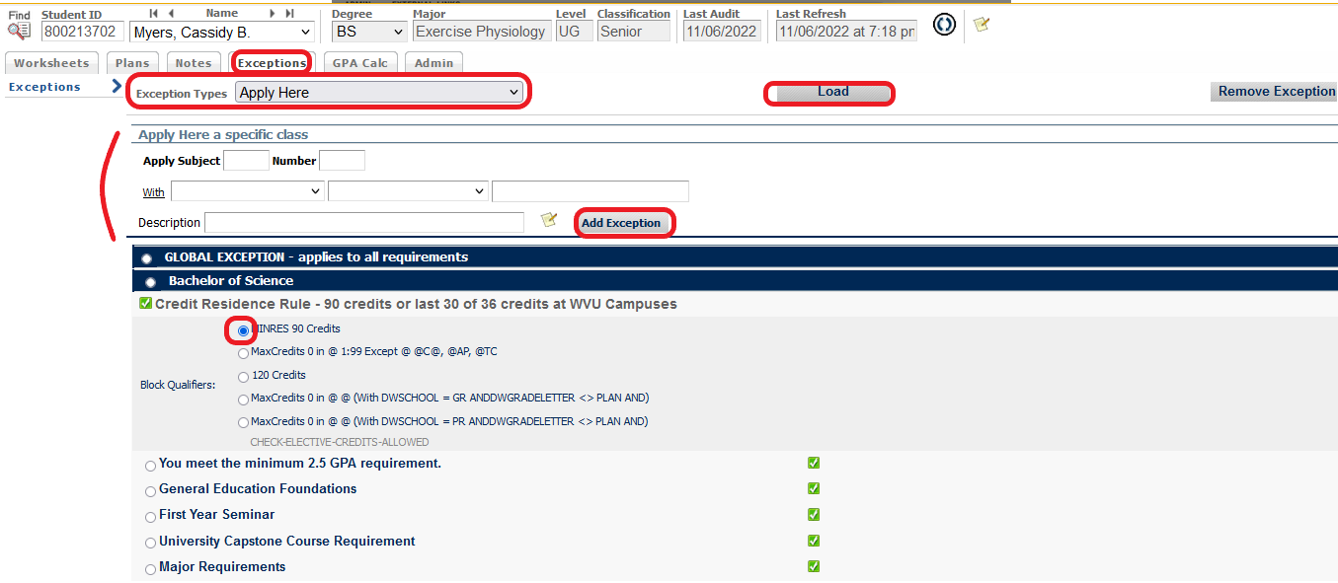
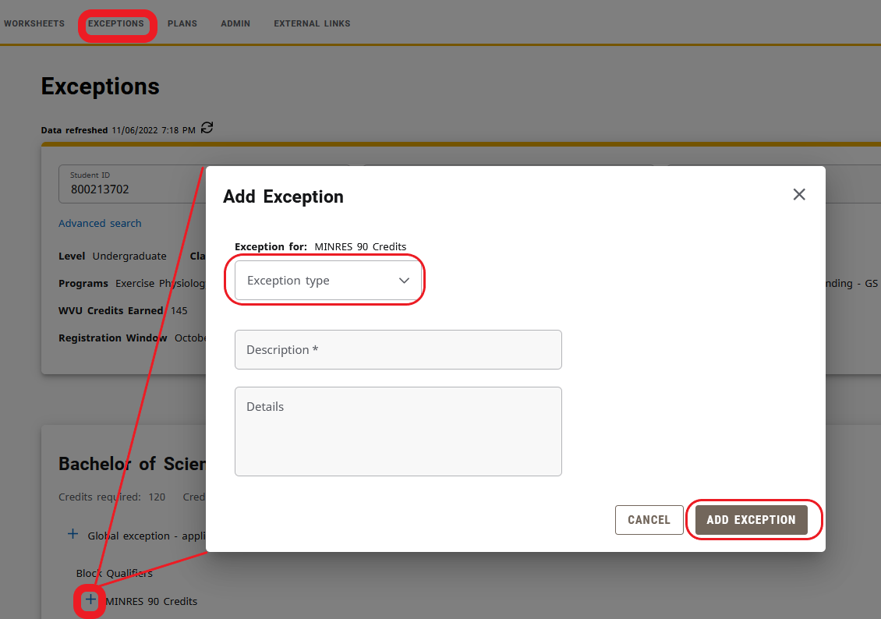
Adding Exceptions
Classic Dashboard
Responsive Dashboard
To navigate to exceptions in Responsive, select the exception tab and locate the requirement needing an exception, clicking on the corresponding + button. Enter the required information for the exception type selected.
Locate the requirement and click on the corresponding ‘+’ icon to activate the exception. Be sure to navigate back to the “worksheet tab” once the exception has been entered.

Slide 26
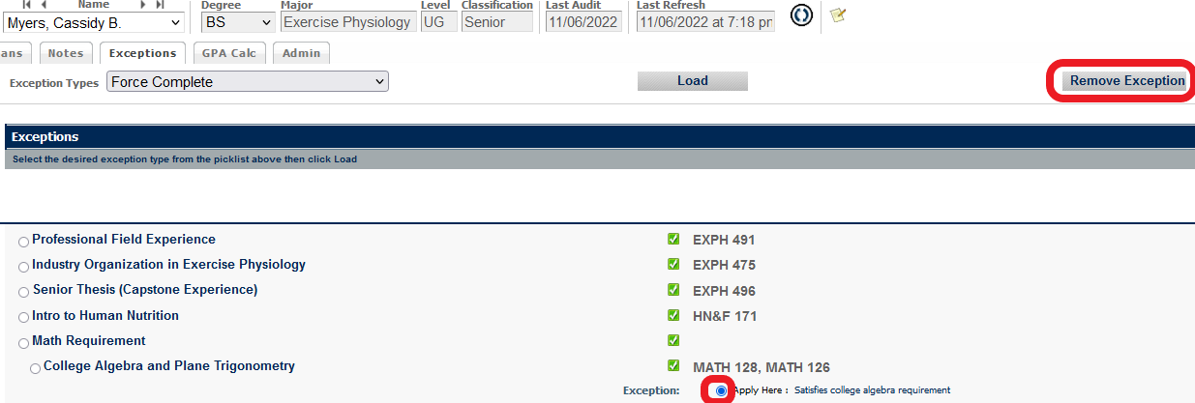
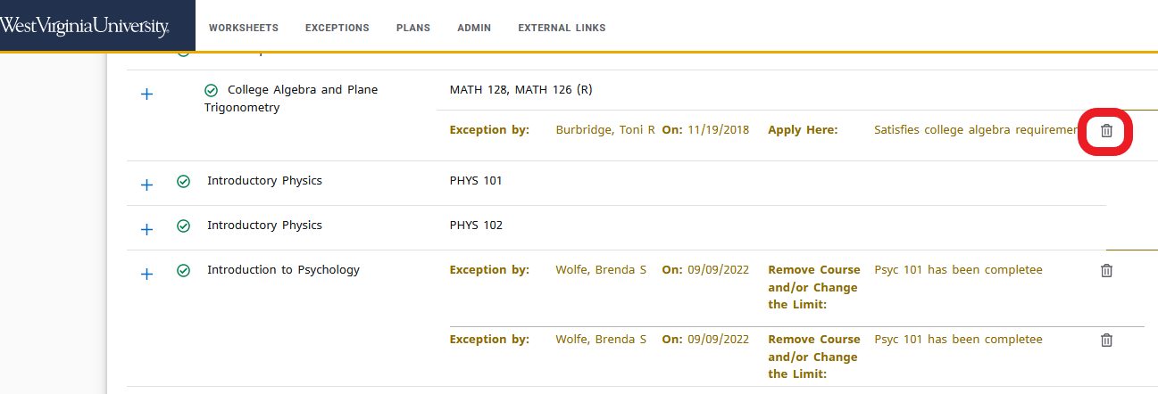
Removing Exceptions
Classic Dashboard
In the Classic Dashboard, you had to locate the exception in the exception tab and click on the corresponding radial button beside it. Select the ‘Remove Exception’ button.
Responsive Dashboard
To remove an exception in Responsive, locate the exception and click on the trash can icon.

Slide 27
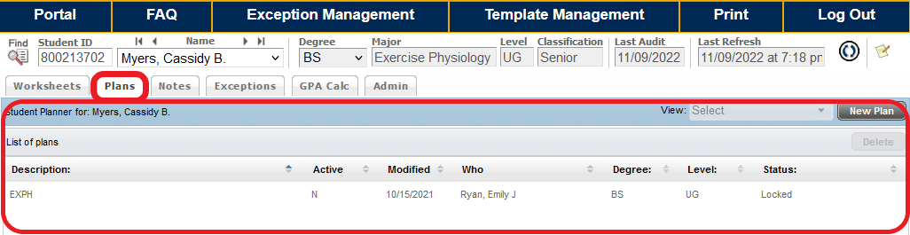
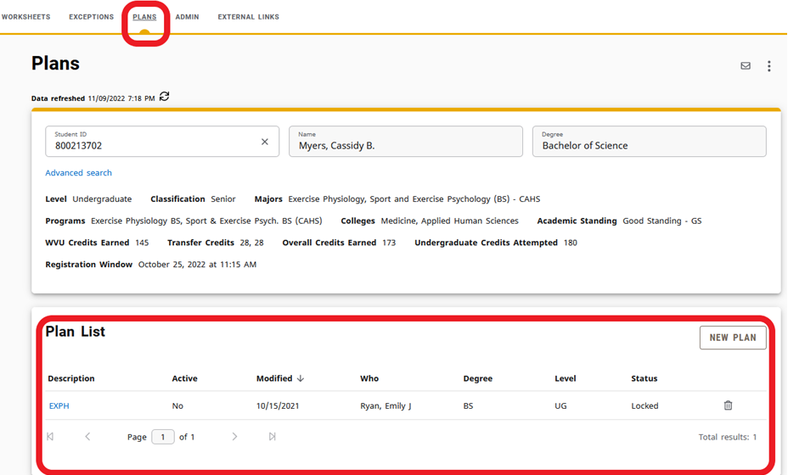
Plans
Classic Dashboard
Responsive Dashboard
The layout and features of the Plans landing page is very similar between dashboards. However, the views are now more intuitive. Upon selecting the plan in the Responsive Dashboard, the plan is automatically in edit mode.

Slide 28
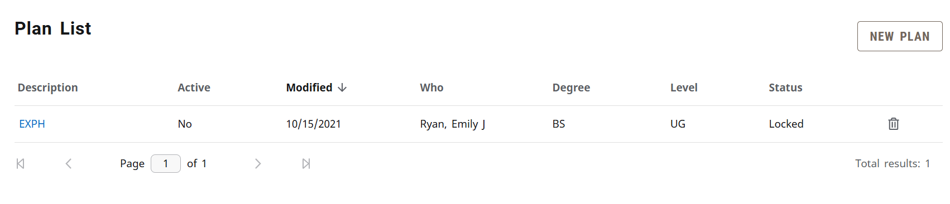
Plans
To Create or View student Plans of Study, select the ‘Plans’ tab from the header bar
The Plan List displays any existing plan. Selecting the plan description will allow for viewing/editing of the plan. To create a new plan, select ‘New plan.’

Slide 29
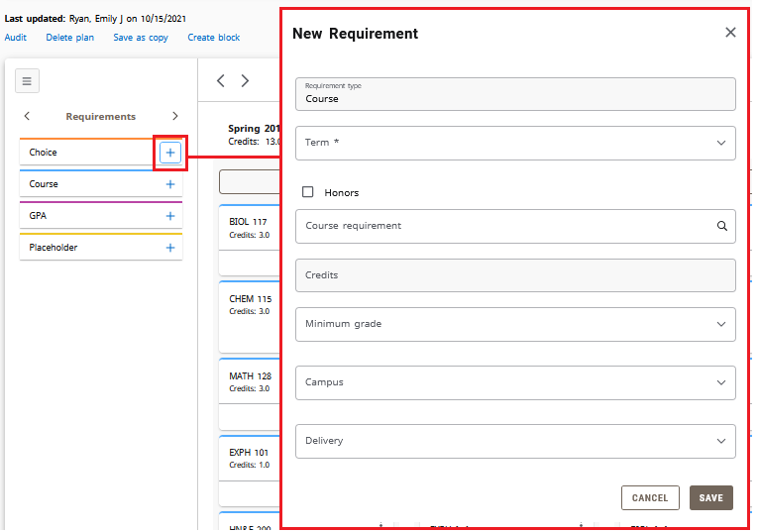
Plans
In the Edit View, the following changes have been made:
The ‘Still Needed’ and ‘Courses’ menus from Classic moved to the left in the Responsive Dashboard and feature the ability to cycle through the menus. Courses listed here feature a drag and drop system too and within Plan terms. Included is a ‘Requirements’ menu containing the familiar ‘Choice’, ‘Course’, ‘GPA’, and ‘Placeholder’ for adding courses.

Slide 30
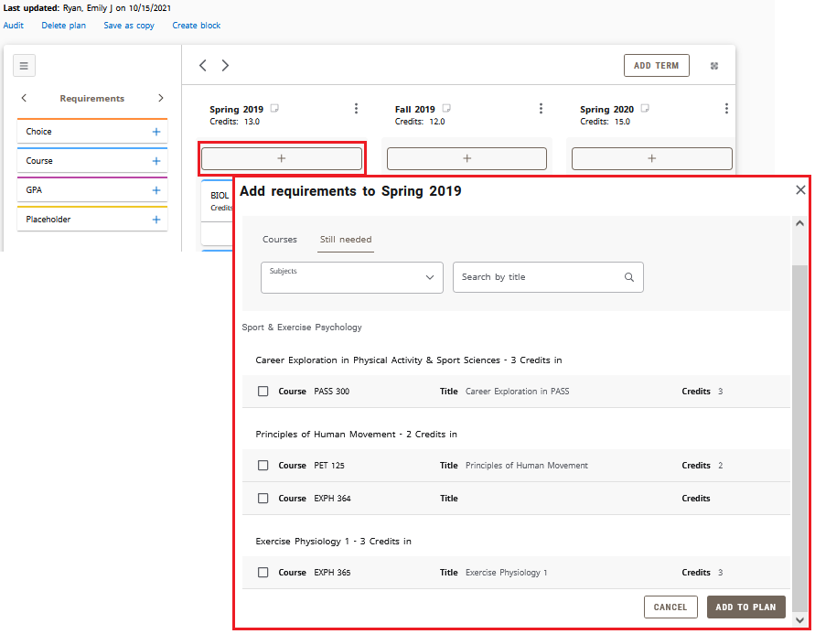
Plans
Additional ways to add requirements in the responsive dashboard is via the + button listed at the top and bottom of each term.

Slide 31
Information and Training Resources
Go to https://registrar.wvu.edu
Click on the Resources and Training Tab
Select Banner/Degreeworks Training and Documentation
This presentation along with information about trainings will be available

Slide 32
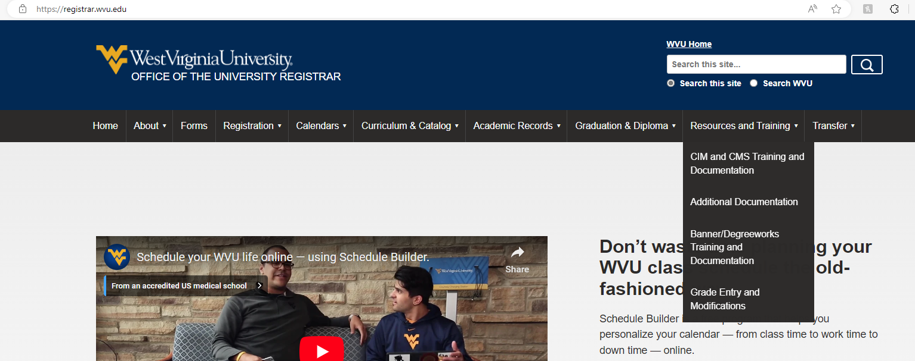
Website Information

Slide 33
Contact Information
Email: degreeworks@mail.wvu.edu
Phone: 304-293-5355

