Slide 1
First-Generation Student Success
Michelle Paden
Coordinator First-Generation Initiatives (FirstGen)
Relator / Harmony / Arranger / Adaptability / Communication
Notes:
Click new slide in the menu bar then select template of choice for title slide and title/text slide formats. You can choose from various colors and textured backgrounds. Displayed is suggested font size and color.

Slide 2
First-Generation Initiatives at WVU
FirstGen is housed in REACH Student Success which falls under the Center for Learning, Advising & Student Success(CLASS).
REACH Student Success is part of Academic Affairs under the Office of the Provost.
Our mission is to help each student achieve their personal academic goals.
Accepted to First ScholarsThird Cohort with FirstGen Forward in Spring 2021.
Implemented FirstGen Steering Committee
IT TAKES A CAMPUS!
Notes:
Example of title and text slide with one column format – blue background and topo texture.

Slide 3
Why FirstGen?
National FirstGen Facts
62% of student veterans are FirstGen
54% of FirstGen students are minorities, compared to 39% for continuing-gen
Median income of FirstGen families is $40K, compared to $100k for continuing-gen
FirstGen graduation rate is 20%, compared to 49%
Potential Impact
4.4 million more work-ready professionals and nearly $700 billion in net benefit to US economy
Those who complete college degrees are:
86% more likely to be employed
More likely to earn higher wages
76% more likely to be civically engaged in their community

Slide 4
NASPA Demographic Characteristics Fact Sheet
Notes:
Example slide with title and text in two column format - Gold background with topo texture.

Slide 5
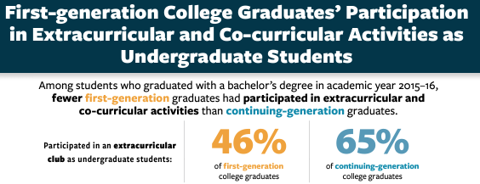
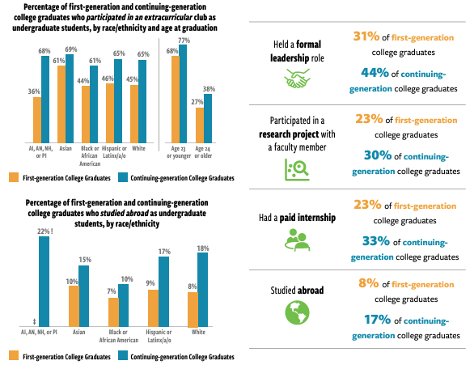
NASPA FirstGen Fact Sheet Extracurricular Activities

Slide 6
Step One: Defining FirstGen
Does your institution have a formal definition?
Does everyone use the same definition?
How are students identified?
Common Application
Institutional Application
FAFSA Application
College/School/Program Specific Definition
Where is the data stored?
Who has access to data?
WVU defines a student as first-generation if neither parent/guardian completed a four-year degree from a college or university within the United States.
When asking a student their FirstGen status:
Provide your definition before asking their status
Document on spreadsheet and meeting notes when they self-identify
Notes:
Example of title and text slide with one column format – blue background and topo texture.

Slide 7
FirstGen Intersectionality
Take a holistic approach to identifying the student
FirstGen +
FirstGen + Low-income
FirstGen + Minority
FirstGen + Transfer Student
FirstGen + Veteran
FirstGen + Non-traditional
FirstGen + ….
Consider your top intersecting identities
What support is offered for those identities?
Do the programs/offices work together?
Are there gaps in services?
Do you refer students?
Notes:
Example slide with title and text in two column format - Gold background with line texture.

Slide 8
Obstacles FirstGen Students Face
College Readiness
Application Process
Financial aid
Housing
Major Selection
Financial Challenges
Often work full-time
Helps support family financially
Low engagement on-campus
Adjusting to College
Imposter syndrome
Jargon
Lack of college readiness skills
High school vs college
Family Support
Understanding requirements outside of class time
Uncertainty of how to support due to lack of experience

Slide 9
Step Two: Foster Community & Sense of Belonging
Show pride in your FirstGen journey or support of FirstGen students
Share your story
Discuss struggles you encountered
Include times when you had to ask for help
Empower and celebrate the strengths of the students and their achievements
Start small where you can make the biggest change immediately

Slide 10
Intrusive Advising
Create the environment of a safe space to discuss their academic journey
Less transactional and more interactive
Ask open-ended questions
Examples of Strengths Based Questions
Encourage questions
No such thing as a dumb question
Evaluate and remove jargon
Connect directly to resources
Introduction email
Direct links
Provide contact information
Quiz the student to ensure they understand what is being discussed
Write the appointment note with the student
Consider extra nudges for important information
Notes:
Questions to consider:
bullet
Are you interested in learning more about what supports already exist for undergraduate and/or graduate first-generation students?
bullet
Are you looking to identify first-generation allies or staff/faculty who identify as first-generation?
bullet
Is your ultimate goal to identify and eliminate gaps in student services?
bullet
Are you looking for successful programs and services to scale?
bullet
Are you looking to identify key stakeholders to serve on the steering committee or working groups?
bullet
Are you looking to identify internal and external stakeholders who can be champions or community collaborators for first-generation efforts?
Action Plan Questions to consider:
bullet
Who needs to be included in order to get a complete picture of first-generation support across the institution (i.e. undergrad and graduate students, staff, faculty, alumni, etc.)?
bullet
What is the best way to gather information from students? How can you involve students to assist with brainstorming and solicit information from peers?
bullet
What is the most efficient method of collecting program and/or staff information?
bullet
If utilizing multiple methods to collect information, how will you consolidate the information?

Slide 11
Future Planning
Offer FirstGen specific freshman seminar courses
Facilitate orientation or recruitment events tailored to FirstGen students
Collaborate with Admissions or Parent’s Club to host FirstGen information sessions
Organize social events for FirstGen students, faculty and staff to meet
Hire FirstGen work study students in your office

Slide 12
Questions?
Michelle Paden
REACH Student Success
studentsuccess.wvu.edu
mlpaden@mail.wvu.edu

