Slide 1
Getting to the Finish Line
Moving Students to Completion

Slide 2
How did we get here?
Gen Z (1995-2007) most college-bound generation ever (57% in 2018).
Students change majors ~3 times over the course of their college career. 80% of students change majors at least once*.
*National Center for Education Statistics

Slide 3
Signs Students Need to Transition
Failure to progress academically
Signs in the system: early alerts, midterms
Difficulty completing critical gateway courses
Failure to utilize resources to aid progression
No tutoring swipes, office hours
Magical thinking
"I can make it up."
Failure (or refusal) to explore other options
"Foreclosed" Students: those who are "steadfastly dedicated" to admission to program and no other -- attachment without consideration of other options. (Denial of this goal creates a crisis.)
http://www.nacada.ksu.edu/Resources/Clearinghouse/View-Articles/Courageous-Conversations-Advising-the-Foreclosed-Student.aspx

Slide 4
What are the characteristics of a "foreclosed" student?
Limited Research
Immature Identity
High Commitment
Pseudo-identity
http://www.nacada.ksu.edu/Resources/Clearinghouse/View-Articles/Courageous-Conversations-Advising-the-Foreclosed-Student.aspx

Slide 5
Challenges of working with "foreclosed" students
Educational limbo
Repeating key classes, failure to progress
Attrition
"I'll just transfer."
Identity Crisis
Adviser becomes "the human embodiment of the rejection notice" -- both the face of the problem and the face of the solution.
https://nacada.ksu.edu/Resources/Clearinghouse/View-Articles/Courageous-Conversations-Advising-the-Foreclosed-Student.aspx

Slide 6
Transition Tactics
Active Listening
Active Planning & "Homework"
Eliminate False Constructs
Build Adaptability
http://www.nacada.ksu.edu/Resources/Clearinghouse/View-Articles/Courageous-Conversations-Advising-the-Foreclosed-Student.aspx

Slide 7
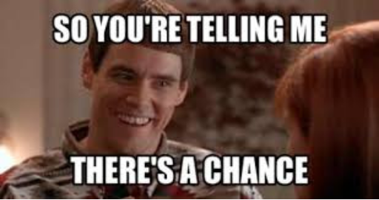
Document Everything

Slide 8
Tips for a Warm Transition
Walk students through available online resources
Catalog, typical plan of study, DegreeWorks "What-if"
Document what is discussed/possible
If a student can return, spell that out clearly
Try to also refer to a colleague
Work with your college to follow major change protocol
Meet your colleagues
The more you are able to describe to a student about who and where they are going, the more likely they are to see the transition as a positive development.

