Slide 1
B.S. Engineering Technology Degree Program Dr. Robin Hensel Dr. Emily Spayde

Slide 2
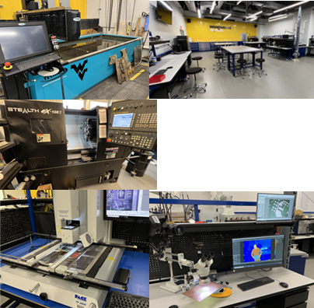
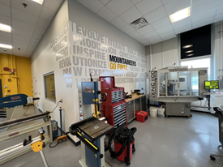
Engineering Technology provides:
Knowledge, hands-on skills, problem-solving ability, and technical leadership needed to enter careers related to:
Preparation of engineering drawings, design, fabrication, and installation
Maintenance, monitoring and improvement of integrated processes and their resulting products and services within an organization
Manufacturing process and system design, testing, operations, continuous quality improvement, lean manufacturing, and sustainability
Technical sales
Manufacturing and industrial competitiveness
Benjamin M. Statler College of Engineering and Mineral Resources

Slide 3
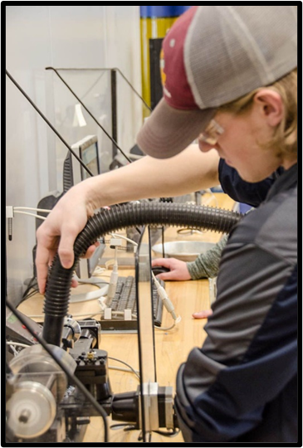
Program Features
Use of industry scale manufacturing equipment
Hands-on, practical, application-based instruction
Industry Certification opportunities within the curriculum:
Solidworks® Associate; Solidworks® Professional
Microsoft ® Excel
Other certifications (NIMS) by student choice
Industry partnerships to provide internship and employment opportunities (in progress)
Benjamin M. Statler College of Engineering and Mineral Resources

Slide 4
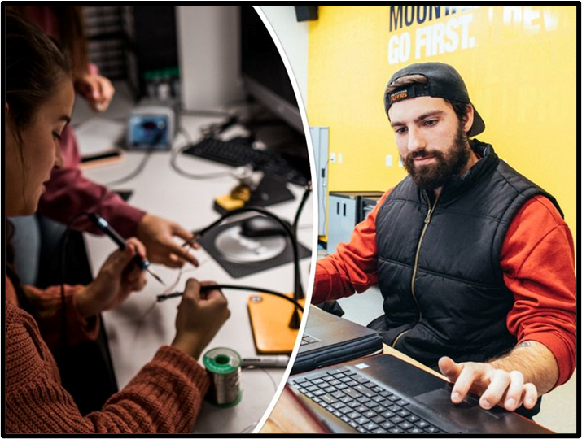
Skills
Design; Solidworks®
Rapid Prototyping
3D Printing
Cutting, Engraving, Routing
Milling, Turning, Welding
Electronics Prototyping
PLC Programming
Benjamin M. Statler College of Engineering and Mineral Resources

Slide 5
Industry Speakers
OSHA Safety
OSHA Safety Overview and Importance in Industry. John Hando & Timothy Dawson, WVU Environmental, Health & Safety (EHS)
Fall Protection. Greg Green, WVU Industrial Extension
Incident (Route 50 Tanker/Logging Truck) Case Study. John Hando, WVU EHS
Fire Training Field Trip. WVU Mine Safety Training Facility. Josh Brady and Josh Caldwell
Industry Representatives
Paul Deavers & Darren Hatfield, ISN Mosebach Electric Supply
Panel of Engineering Technology Professionals

Slide 6
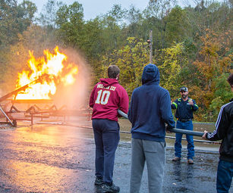
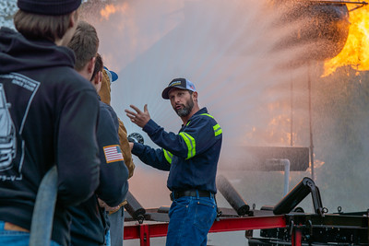
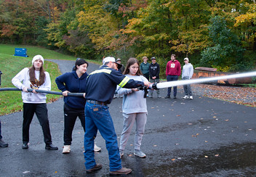
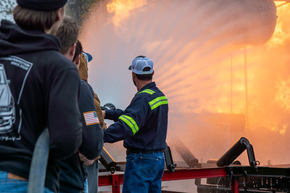
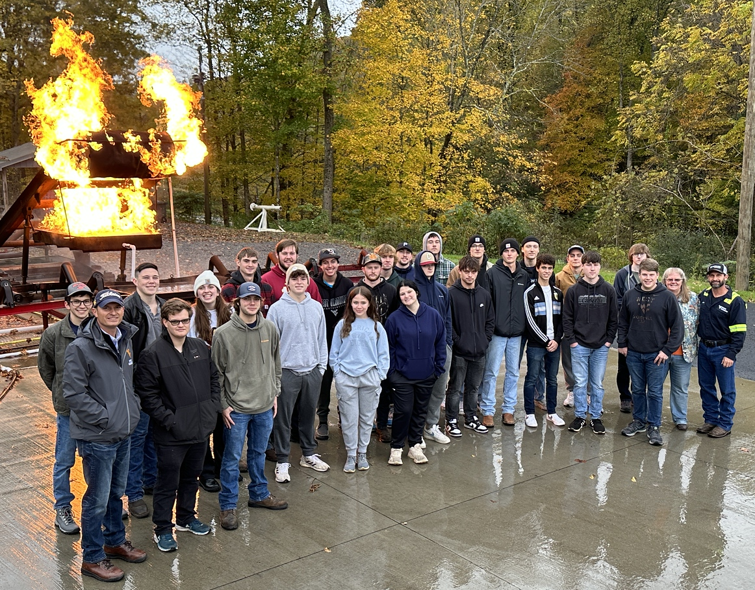
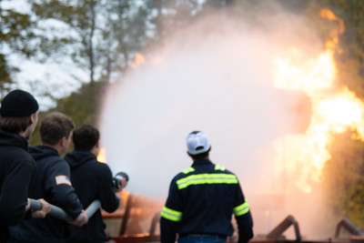
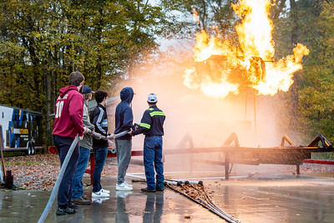
ETEC Fire Training Experience at the WVU Mine Safety Training Facility
10/16/2023

Slide 7
ABET ETEC Learning Outcomes
Upon completion of the ETEC program, students will have the ability to:
Apply knowledge, techniques, skills and modern tools of mathematics, science, engineering, and technology to solve broadly-defined engineering problems appropriate to the discipline;
Design systems, components, or processes meeting specific needs for broadly-defined engineering problems appropriate to the discipline;
Apply written, oral, and graphical communication in broadly-defined technical and non-technical environments; and an ability to identify and use appropriate technical literature;
Conduct standard tests, measurements, and experiments to analyze and interpret the results to improve processes; and
Function effectively as a member as well as a leader on technical teams.

Slide 8
Curriculum
General Manufacturing Base + Select 2 Areas of Emphasis
Mechanical Engineering Technology
Industrial Engineering Technology
Multi-disciplinary Engineering Technology
Energy Technology
Engineering Management & Entrepreneurship
Application Requirement & Engineering Technology Capstone Requirement

Slide 9
Application Requirement (3 cr)
May be applied to any AoE within the ETEC program
ETEC 370: Applied Workshop. (1) Formal structure for active engagement on student competition teams related to engineering and engineering technology. Application of skills to solving large challenges; teamwork; professionalism and engineering ethics; technical problem-solving
ETEC 450: Technology Certification (1) Structure for preparation for industry certification beyond those offered within the regular curriculum
ETEC 491: Professional Field Experience (1 – 18) Prearranged experiential learning program to be planned, supervised, and evaluated for credit by faculty and field supervisors. Involves temporary placement with a public or private enterprise for professional competence development.

Slide 10
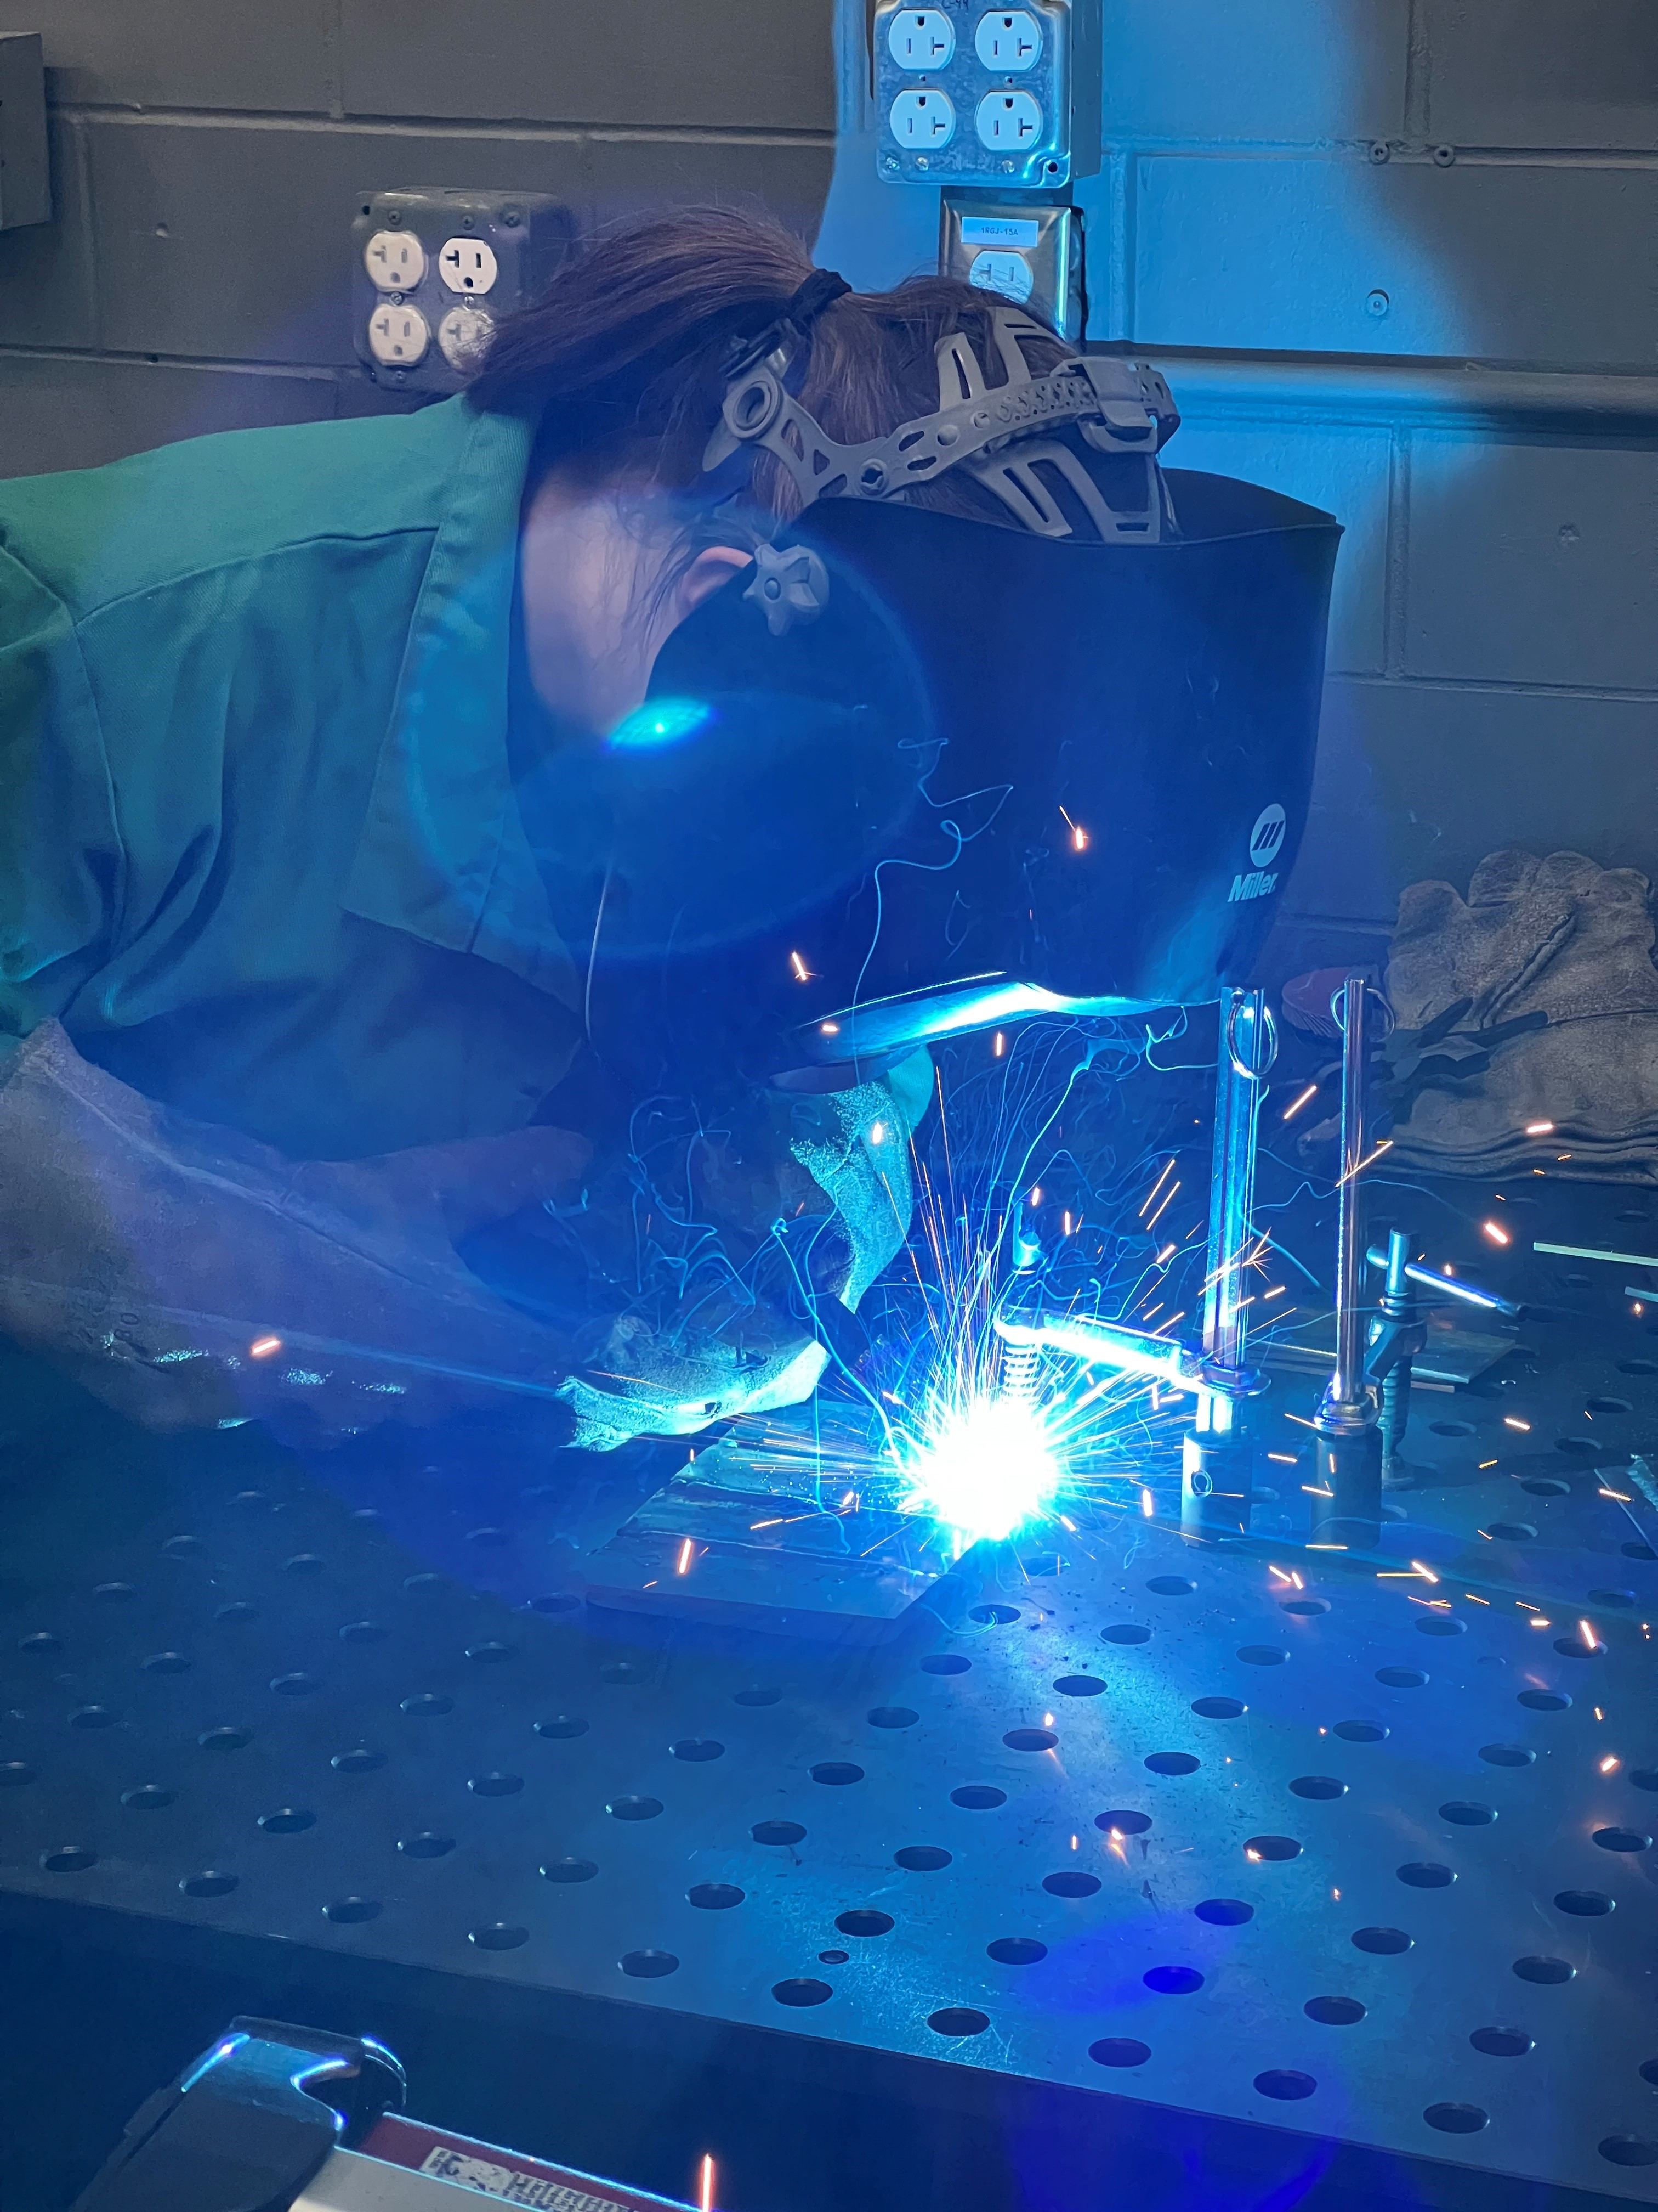
Plan of Study
Benjamin M. Statler College of Engineering and Mineral Resources

Slide 11
Program of Study
Math & Science Requirements
MATH 150 & 151, Applied Calculus 1 & 2
STAT 211, Statistics
PHYS 101/L & 102/L, General Physics
CHEM 111/L, General Chemistry
Statler Requirements
ENGR 101 & ENGR 102, Engr Problem Solving 1 & 2
Other ETEC Requirements
BCOR 121 or CS 101/L
ENGR 140, Engineering in History
IENG 377, Engineering Economy
IENG 445, Project Management
WRIT 305, Technical Writing
ETEC Courses
ETEC 199, Intro to ETEC
ETEC 130/L – Manufacturing Processes 1
ETEC 210/L Engr Graphics & Geometry
ETEC 220/L – Applications of Technology
ETEC 310/L – Material Science with Applications
ETEC 330/L – Manufacturing Processes 2
ETEC 340/L – Electronic Circuits
ETEC 350 – Analysis for Engineering Tech
ETEC 401 – Science, Technology, & Society
ETEC 440/L – Industrial Automation PLC 1
ETEC 475S – ETEC Capstone Experience
WVU GEC Requirements (including ENGR 191)

Slide 12
Areas of Emphasis
Mechanical Engineering Technology
9-12 credits in: AGEE 303, or FNRS 333, 337/L, 341/L, or MAE 211,241, 459, or 300+ or 400+ (Except MAE 312)
3 credits in ETEC 370*, 450*, or 491
Industrial Engineering Technology
9-12 credits in: COMM 306, or DSGN 270, or GSCM 450*, or IENG 220*,331*,461, 473, or SAFM 470 or 471, or IENG 200+, 300+, or 400+ (except IENG 377 or 445)
3 credits in ETEC 370*, 450*, or 491
Energy Technology
9-12 credits in: ARE 445, or DSGN 280, 340, or 470*, or ENGR 310 or ENLM 200, 220, 250, or 300*, 415*, 442*, or IENG 433, or MAE 320*, or ETEC 320, or RESM 405L, 440/L, or 460, or CHE 200+, CHE 300+, CHE 400+, or MINE 200+, MINE 300+, or MINE 400+, or PNGE 200+, or PNGE 300+, or PNGE 400+
3 credits in ETEC 370*, 450*, or 491
Engineering Mgt & Entrepreneurship
9-12 credits in: BCOR 320, 330, 340, 350, 360, 370, or 380 or COMM 404 or 335, or ENGR 450, or ENTR 400, 405*, 420*, 430*, 436*, 440*, 455*, or 460* or HRMG 470, or IENG 474
3 credits in ETEC 370*, 450*, or 491
Multi-Disciplinary Engineering Technology
Students create their own plan with approval
No courses counting in the MDET AoE may be counted toward any other ETEC AoE
3 credits in ETEC 370*, 450*, or 491
NOTE: The 3-credit Application Requirement may be counted in any ONE of the ETEC AoEs

Slide 13
Occupational Outlook
Employers who hire Engineering Technologists:

Slide 14
What program is right for you?
 | Engineering Technology | Engineering
Graduate | Implementer: Hands-on lab testing or field job in product design, testing, manufacturing, construction, or technical services | Innovator: Research, development, conceptual design, or management
Curriculum | Focus: Solve defined technical and standard design problems Content: Math level is not as in-depth as in traditional engineering programs Timeline: Hands-on application focus beginning in first year | Focus: Theory, conceptual design, analysis, and solutions for open-ended, complex, and unique design problems Content: Multiple terms of calculus and calculus-based science courses Timeline: Math and science intensive in first 2 years, followed by engineering analysis focus in 3rd and 4th years.
Graduate School | Readily Accepted: MBA, Facilities Mgt, others | Readily Accepted: Advanced Engineering, MBA, others
Professional License | Eligible in WV, OH, VA & other states; Variation in licensing requirements | Eligible in ALL states; FE & PE Exams + documented experience
Benjamin M. Statler College of Engineering and Mineral Resources

Slide 15
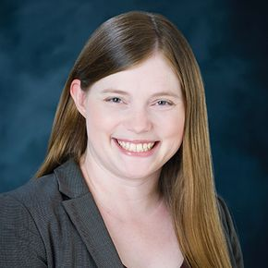
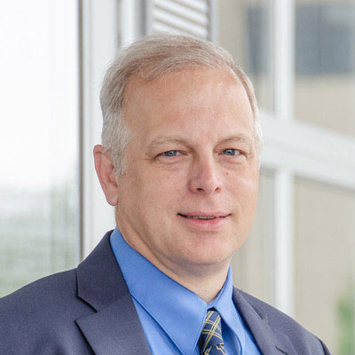
ETEC Faculty
Dr. Robin Hensel
Teaching Professor
ASEE Fellow
Robin.Hensel@mail.wvu.edu
Dr. Emily Spayde
Teaching Assistant Professor
Emily.Spayde@mail.wvu.edu
Dr. Todd Hamrick
Teaching Professor
Todd.Hamrick@mail.wvu.edu
Dr. Kolin Brown
Adjunct Instructor
Safety & Chemical Hygiene Coordinator
Kolin.Brown@mail.wvu.edu

Slide 16
QUESTIONS?
Thank You
Dr. Robin Hensel Robin.Hensel@mail.wvu.edu
Dr. Emily Spayde Emily.Spayde@mail.wvu.edu

