Slide 1
WVU’s Updated STEM Path – Starting Fall 2024
Stephanie Young, Ph.D.
Director of the Foundational STEM Collaborative (FSC)
Teaching Associate Professor, Department of Biology

Slide 2
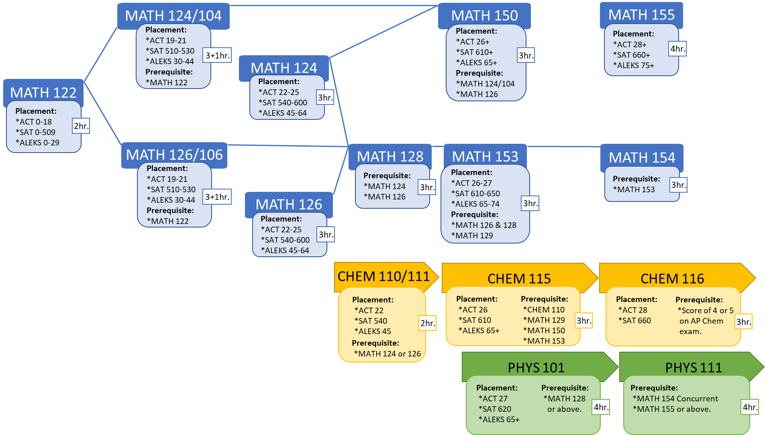
Why Update the “STEM Path”?
The STEM Path is the route students take through their introductory coursework in BIOL, CHEM, MATH, and PHYS.
In Spring 2022, Eberly College called a group of faculty together from these units to discuss a better-aligned, streamlined, and more accessible path for students.
First initiative of the Foundational STEM Collaborative.
Current STEM Path
2023-2024

Slide 3
The Updated STEM Path
Today we will introduce:
How the updated path is different from the current path.
How future students can change from one MATH path to another.
How current students will migrate into the new path.
Where to find more information.

Slide 4
Updated
STEM Path
MATH 124
MATH 150
MATH 151
Placement:
ACT 20-25
SAT 520-600
ALEKS 40-64
Prerequisite:
MATH 122 C-
Placement:
ACT 26+
SAT 610+
ALEKS 65+
Prerequisite:
MATH 124 C-
MATH 126 C-
Pre-Calc AP (Score 3)
Prerequisite:
MATH 150
MATH 155
Applied Pathway
3hr.
2024-2025
3hr.
3hr.
MATH 122
Placement:
ACT 0-21
SAT 0-530
ALEKS 0-44
MATH 155
Pathway
3hr.
MATH 126
MATH 128
MATH 155
Placement:
ACT 22-25
SAT 540-600
ALEKS 45-64
Prerequisite:
MATH 122 C-
Prerequisite:
MATH 126 C-
3hr.
MATH 129
Placement:
ACT 28+
SAT 660+
ALEKS 75+
Prerequisite:
MATH 126 C- + MATH 128 C-
MATH 129 C-
3hr.
Placement:
ACT 26-27
SAT 610-650
ALEKS 65-74
Prerequisite:
Pre-Calc AP (Score 3)
4hr.
4hr.
CHEM 110/111
CHEM 115
CHEM 116
Placement:
ACT 20
SAT 520
ALEKS 40
Concurrent:
MATH 124 or 126
Placement:
ACT 26
SAT 610
ALEKS 65+
Prerequisite:
CHEM 110
Concurrent:
MATH 129 or MATH 150
Prerequisite:
CHEM 115 C-
3hr.
2hr.
3hr.
PHYS 101
PHYS 102
Placement:
ACT 26
SAT 610
ALEKS 65+
Prerequisite:
MATH 124 C- or
MATH 126 C-
Concurrent:
MATH 129 or MATH 150
Prerequisite:
PHYS 101 C-
4hr.
4hr.
*PHYS 111 placement and
prerequisites – no change.

Slide 5
Updated
STEM Path
MATH 124
MATH 150
MATH 151
Placement:
ACT 20-25
SAT 520-600
ALEKS 40-64
Prerequisite:
MATH 122 C-
Placement:
ACT 26+
SAT 610+
ALEKS 65+
Prerequisite:
MATH 124 C-
MATH 126 C-
Pre-Calc AP (Score 3)
Prerequisite:
MATH 150
MATH 155
Applied Pathway
3hr.
2024-2025
3hr.
3hr.
MATH 122
MATH 122
Placement:
ACT 0-21
SAT 0-530
ALEKS 0-44
MATH 155
Placement:
ACT 0-21
SAT 0-530
ALEKS 0-44
Pathway
3hr.
MATH 126
MATH 128
MATH 155
3hr.
Placement:
ACT 22-25
SAT 540-600
ALEKS 45-64
Prerequisite:
MATH 122 C-
Prerequisite:
MATH 126 C-
3hr.
MATH 129
Placement:
ACT 28+
SAT 660+
ALEKS 75+
Prerequisite:
MATH 126 C- + MATH 128 C-
MATH 129 C-
3hr.
Placement:
ACT 26-27
SAT 610-650
ALEKS 65-74
Prerequisite:
Pre-Calc AP (Score 3)
4hr.
4hr.
MATH 122:
Offered as a 3-credit course with a redesigned curriculum for majors that require MATH 124 or 126 or higher.
Lecture-based
ALEKS offered in class as a way for students to gauge their own learning.
Will serve as a GEF course for students who change majors to one that requires less MATH than the STEM Path.

Slide 6
Updated
STEM Path
MATH 124
MATH 150
MATH 151
MATH 124
Placement:
ACT 20-25
SAT 520-600
ALEKS 40-64
Prerequisite:
MATH 122 C-
Placement:
ACT 20-25
SAT 520-600
ALEKS 40-64
Prerequisite:
MATH 122 C-
Placement:
ACT 26+
SAT 610+
ALEKS 65+
Prerequisite:
MATH 124 C-
MATH 126 C-
Pre-Calc AP (Score 3)
Prerequisite:
MATH 150
MATH 155
Applied Pathway
3hr.
2024-2025
3hr.
3hr.
3hr.
MATH 122
Placement:
ACT 0-21
SAT 0-530
ALEKS 0-44
MATH 155
Pathway
MATH 126
MATH 128
MATH 155
3hr.
MATH 126
Placement:
ACT 22-25
SAT 540-600
ALEKS 45-64
Prerequisite:
MATH 122 C-
Prerequisite:
MATH 126 C-
MATH 129
Placement:
ACT 28+
SAT 660+
ALEKS 75+
Prerequisite:
MATH 126 C- + MATH 128 C-
MATH 129 C-
Placement:
ACT 22-25
SAT 540-600
ALEKS 45-64
Prerequisite:
MATH 122 C-
3hr.
3hr.
Placement:
ACT 26-27
SAT 610-650
ALEKS 65-74
Prerequisite:
Pre-Calc AP (Score 3)
3hr.
4hr.
4hr.
MATH 104 and 106:
An updated curriculum for MATH 124 and MATH 126 no longer requires MATH 104 and 106.
MATH 124:
Placement scores updated (lowered slightly) based on current student success data.

Slide 7
Updated
STEM Path
MATH 124
MATH 150
MATH 151
Placement:
ACT 20-25
SAT 520-600
ALEKS 40-64
Prerequisite:
MATH 122 C-
Placement:
ACT 26+
SAT 610+
ALEKS 65+
Prerequisite:
MATH 124 C-
MATH 126 C-
Pre-Calc AP (Score 3)
Prerequisite:
MATH 150
MATH 155
Applied Pathway
3hr.
2024-2025
3hr.
3hr.
MATH 122
Placement:
ACT 0-21
SAT 0-530
ALEKS 0-44
MATH 155
Pathway
3hr.
MATH 126
MATH 128
MATH 155
Prerequisite:
MATH 126 C-
MATH 129
Placement:
ACT 28+
SAT 660+
ALEKS 75+
Prerequisite:
MATH 126 C- + MATH 128 C-
MATH 129 C-
Placement:
ACT 22-25
SAT 540-600
ALEKS 45-64
Prerequisite:
MATH 122 C-
3hr.
MATH 129
Placement:
ACT 26-27
SAT 610-650
ALEKS 65-74
Prerequisite:
Pre-Calc AP (Score 3)
3hr.
Placement:
ACT 26-27
SAT 610-650
ALEKS 65-74
Prerequisite:
Pre-Calc AP (Score 3)
4hr.
4hr.
4hr.
MATH 153 and MATH 154:
MATH 153 and MATH 154 will be phased out as students are prepared for MATH 155 directly through pre-requisite coursework.
MATH 129:
MATH 129 will again be an available offering in Fall 2024 for students that place, serving as a pre-requisite course for MATH 155.

Slide 8
Updated
STEM Path
MATH 124
MATH 150
MATH 151
Placement:
ACT 20-25
SAT 520-600
ALEKS 40-64
Prerequisite:
MATH 122 C-
Placement:
ACT 26+
SAT 610+
ALEKS 65+
Prerequisite:
MATH 124 C-
MATH 126 C-
Pre-Calc AP (Score 3)
Prerequisite:
MATH 150
MATH 155
Applied Pathway
3hr.
2024-2025
3hr.
3hr.
MATH 122
Placement:
ACT 0-21
SAT 0-530
ALEKS 0-44
MATH 155
Pathway
MATH 126
MATH 128
MATH 155
3hr.
MATH 155
Prerequisite:
MATH 126 C-
MATH 129
Placement:
ACT 28+
SAT 660+
ALEKS 75+
Prerequisite:
MATH 126 C- + MATH 128 C-
MATH 129 C-
Placement:
ACT 22-25
SAT 540-600
ALEKS 45-64
Prerequisite:
MATH 122 C-
3hr.
Placement:
ACT 28+
SAT 660+
ALEKS 75+
Prerequisite:
MATH 126 C- + MATH 128 C-
MATH 129 C-
3hr.
Placement:
ACT 26-27
SAT 610-650
ALEKS 65-74
Prerequisite:
Pre-Calc AP (Score 3)
4hr.
4hr.
4hr.
MATH 155:
Placement will not change, starting Fall 2025, prerequisite coursework will lead to course access.

Slide 9
Updated
STEM Path
MATH 124
MATH 150
MATH 151
Placement:
ACT 20-25
SAT 520-600
ALEKS 40-64
Prerequisite:
MATH 122 C-
Placement:
ACT 26+
SAT 610+
ALEKS 65+
Prerequisite:
MATH 124 C-
MATH 126 C-
Pre-Calc AP (Score 3)
Prerequisite:
MATH 150
MATH 155
Applied Pathway
3hr.
2024-2025
3hr.
3hr.
MATH 122
Placement:
ACT 0-21
SAT 0-530
ALEKS 0-44
MATH 155
Pathway
3hr.
MATH 126
MATH 128
MATH 155
Placement:
ACT 22-25
SAT 540-600
ALEKS 45-64
Prerequisite:
MATH 122 C-
Prerequisite:
MATH 126 C-
3hr.
MATH 129
Placement:
ACT 28+
SAT 660+
ALEKS 75+
Pre-req:
MATH 126 C- + MATH 128 C-
MATH 129 C-
3hr.
Placement:
ACT 26-27
SAT 610-650
ALEKS 65-74
Prerequisite:
Pre-Calc AP (Score 3)
4hr.
4hr.
CHEM 110/111
CHEM 115
CHEM 116
CHEM 110/111
Placement:
ACT 20
SAT 520
ALEKS 40
Concurrent:
MATH 124 or 126
Placement:
ACT 26
SAT 610
ALEKS 65+
Prerequisite:
CHEM 110
Concurrent:
MATH 129 or MATH 150
Placement:
ACT 20
SAT 520
ALEKS 40
Concurrent:
MATH 124 or 126
Prerequisite:
CHEM 115 C-
3hr.
2hr.
2hr.
3hr.
CHEM 110/111:
CHEM 110 and CHEM 111 placement updated to allow for concurrency with MATH 124 or MATH 126.
PHYS 101
PHYS 102
Placement:
ACT 26
SAT 610
ALEKS 65+
Prerequisite:
MATH 124 C- or
MATH 126 C-
Concurrent:
MATH 129 or MATH 150
Prerequisite:
PHYS 101 C-
4hr.
4hr.
*PHYS 111 placement and
prerequisites – no change.

Slide 10
Updated
STEM Path
MATH 124
MATH 150
MATH 151
Placement:
ACT 20-25
SAT 520-600
ALEKS 40-64
Prerequisite:
MATH 122 C-
Placement:
ACT 26+
SAT 610+
ALEKS 65+
Prerequisite:
MATH 124 C-
MATH 126 C-
Pre-Calc AP (Score 3)
Prerequisite:
MATH 150
MATH 155
Applied Pathway
3hr.
2024-2025
3hr.
3hr.
MATH 122
Placement:
ACT 0-21
SAT 0-530
ALEKS 0-44
MATH 155
Pathway
3hr.
MATH 126
MATH 128
MATH 155
Placement:
ACT 22-25
SAT 540-600
ALEKS 45-64
Prerequisite:
MATH 122 C-
Prerequisite:
MATH 126 C-
3hr.
MATH 129
Placement:
ACT 28+
SAT 660+
ALEKS 75+
Pre-req:
MATH 126 C- + MATH 128 C-
MATH 129 C-
3hr.
Placement:
ACT 26-27
SAT 610-650
ALEKS 65-74
Prerequisite:
Pre-Calc AP (Score 3)
4hr.
4hr.
CHEM 110/111
CHEM 115
CHEM 116
Placement:
ACT 20
SAT 520
ALEKS 40
Concurrent:
MATH 124 or 126
Placement:
ACT 26
SAT 610
ALEKS 65+
Prerequisite:
CHEM 110
Concurrent:
MATH 129 or MATH 150
Prerequisite:
CHEM 115 C-
3hr.
2hr.
3hr.
PHYS 101:
Prerequisite coursework for PHYS 101 updated to MATH 124 or MATH 126.
MATH 128 no longer required.
Can be taken concurrently with MATH 129 or MATH 150.
PHYS 101
PHYS 102
PHYS 101
Prerequisite:
MATH 124 C- or
MATH 126 C-
Concurrent:
MATH 129 or MATH 150
Placement:
ACT 26
SAT 610
ALEKS 65+
Prerequisite:
MATH 124 C- or
MATH 126 C-
Concurrent:
MATH 129 or MATH 150
Prerequisite:
PHYS 101 C-
Placement:
ACT 26
SAT 610
ALEKS 65+
4hr.
4hr.
4hr.
*PHYS 111 placement and
prerequisites – no change.

Slide 11
Updated
STEM Path
MATH 124
MATH 150
MATH 151
Placement:
ACT 20-25
SAT 520-600
ALEKS 40-64
Prerequisite:
MATH 122 C-
Placement:
ACT 26+
SAT 610+
ALEKS 65+
Prerequisite:
MATH 124 C-
MATH 126 C-
Pre-Calc AP (Score 3)
Prerequisite:
MATH 150
MATH 155
Applied Pathway
3hr.
2024-2025
3hr.
3hr.
MATH 122
Placement:
ACT 0-21
SAT 0-530
ALEKS 0-44
MATH 155
Pathway
3hr.
MATH 126
MATH 128
MATH 155
Placement:
ACT 22-25
SAT 540-600
ALEKS 45-64
Prerequisite:
MATH 122 C-
Prerequisite:
MATH 126 C-
3hr.
MATH 129
Placement:
ACT 28+
SAT 660+
ALEKS 75+
Pre-req:
MATH 126 C- + MATH 128 C-
MATH 129 C-
3hr.
Placement:
ACT 26-27
SAT 610-650
ALEKS 65-74
Prerequisite:
Pre-Calc AP (Score 3)
4hr.
4hr.
CHEM 110/111
CHEM 115
CHEM 116
Placement:
ACT 20
SAT 520
ALEKS 40
Concurrent:
MATH 124 or 126
Placement:
ACT 26
SAT 610
ALEKS 65+
Prerequisite:
CHEM 110
Concurrent:
MATH 129 or MATH 150
Prerequisite:
CHEM 115 C-
3hr.
2hr.
3hr.
PHYS 101
PHYS 102
Placement:
ACT 26
SAT 610
ALEKS 65+
Prerequisite:
MATH 124 C- or
MATH 126 C-
Concurrent:
MATH 129 or MATH 150
Prerequisite:
PHYS 101 C-
4hr.
4hr.
*PHYS 111 placement and
prerequisites – no change.

Slide 12
MATH 124
MATH 150
MATH 151
Placement:
ACT 20-25
SAT 520-600
ALEKS 40-64
Prerequisite:
MATH 122 C-
Placement:
ACT 26+
SAT 610+
ALEKS 65+
Prerequisite:
MATH 124 C-
MATH 126 C-
Pre-Calc AP (Score 3)
Prerequisite:
MATH 150 C-
MATH 155 C-
Applied Pathway
3hr.
3hr.
3hr.
MATH 122
MATH 129
Placement:
ACT 0-21
SAT 0-530
ALEKS 0-44
Placement:
ACT 26-27
SAT 610-650
ALEKS 65-74
Prerequisite:
Pre-Calc AP (Score 3)
3hr.
4hr.
GEF for students changing majors to one that requires less MATH.
MATH 155 Pathway
MATH 126
MATH 128
MATH 155
Placement:
ACT 22-25
SAT 540-600
ALEKS 45-64
Prerequisite:
MATH 122 C-
Prerequisite:
MATH 126 C-
3hr.
Placement:
ACT 28+
SAT 660+
ALEKS 75+
Pre-requisite:
MATH 126 C- + MATH 128 C-
MATH 129 C-
Pre-Calc AP (Score 4)
3hr.
4hr.
Updated MATH Path: Changing Paths – MATH 155 to Applied
2024-2025

Slide 13
MATH 124
MATH 150
MATH 151
Placement:
ACT 20-25
SAT 520-600
ALEKS 40-64
Prerequisite:
MATH 122 C-
Placement:
ACT 26+
SAT 610+
ALEKS 65+
Prerequisite:
MATH 124 C-
MATH 126 C-
Pre-Calc AP (Score 3)
Prerequisite:
MATH 150 C-
MATH 155 C-
Applied Pathway
3hr.
3hr.
3hr.
MATH 122
MATH 129
Placement:
ACT 0-21
SAT 0-530
ALEKS 0-44
2. Self-Paced ALEKS (placement only)
Placement:
ACT 26-27
SAT 610-650
ALEKS 65-74
Prerequisite:
Pre-Calc AP (Score 3)
3hr.
1. Course-Based
4hr.
MATH 155 Pathway
MATH 126
MATH 128
MATH 155
Placement:
ACT 22-25
SAT 540-600
ALEKS 45-64
Prerequisite:
MATH 122 C-
Prerequisite:
MATH 126 C-
Placement:
ACT 28+
SAT 660+
ALEKS 75+
Pre-requisite:
MATH 126 C- + MATH 128 C-
MATH 129 C-
Pre-Calc AP (Score 4)
3hr.
3hr.
4hr.
Updated MATH Path: Changing Paths – Applied to MATH 155
2024-2025

Slide 14
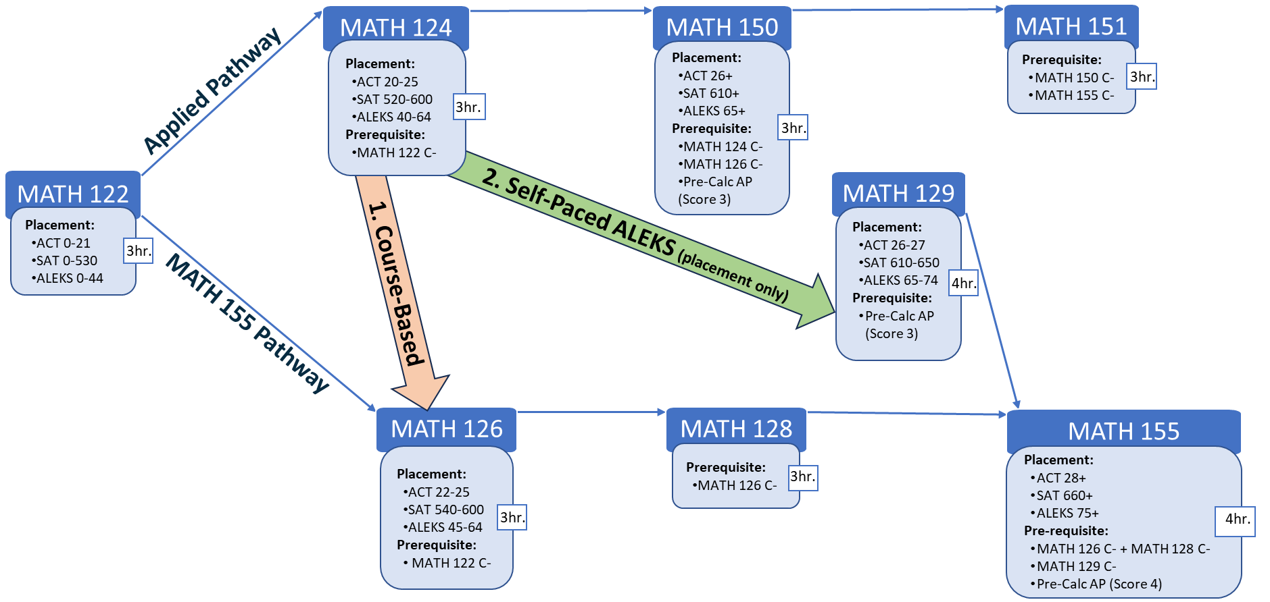
Path Change Recommendations:
Course-Based
Students who earned lower than a B in MATH 124 and/or an ALEKS score lower than 45.
Self-Paced
Students who earned an A or B in MATH 124 and/or an ALEKS score of 45-64.
Updated MATH Path: Changing Paths – Applied to MATH 155
2024-2025

Slide 15
Effect on STEM Course Progression
MATH 122 Start
CHEM 111/112
Applied Pathway
Semester 1
Semester 2
Semester 3
Semester 4
Semester 5
MATH 122
MATH 124
MATH 150
MATH 104
Current STEM Path
CHEM 111
CHEM 112
PHYS 101
PHYS 102
MATH 122
MATH 124
MATH 150
Proposed STEM Path
CHEM 111
CHEM 112
PHYS 101
PHYS 102

Slide 16
Effect on STEM Course Progression
MATH 122 Start
CHEM 115/116
Applied Pathway
Semester 1
Semester 2
Semester 3
Semester 4
Semester 5
MATH 122
MATH 124
MATH 150
MATH 104
Current STEM Path
CHEM 110
CHEM 115
CHEM 116
PHYS 101
PHYS 102
MATH 122
MATH 124
MATH 150
Proposed STEM Path
CHEM 110
CHEM 115
CHEM 116
PHYS 101
PHYS 102

Slide 17
Effect on STEM Course Progression
MATH 122 Start
CHEM 115/116
MATH 155 –Bound Pathway
Semester 1
Semester 2
Semester 3
Semester 4
Semester 5
MATH 122
MATH 126
MATH 128
MATH 153
MATH 154
MATH 106
Current STEM Path
CHEM 110
CHEM 115
CHEM 116
PHYS 101
PHYS 102
MATH 122
MATH 126
MATH 128
MATH 155
Proposed STEM Path
CHEM 110
CHEM 115
CHEM 116
PHYS 101
PHYS 102

Slide 18
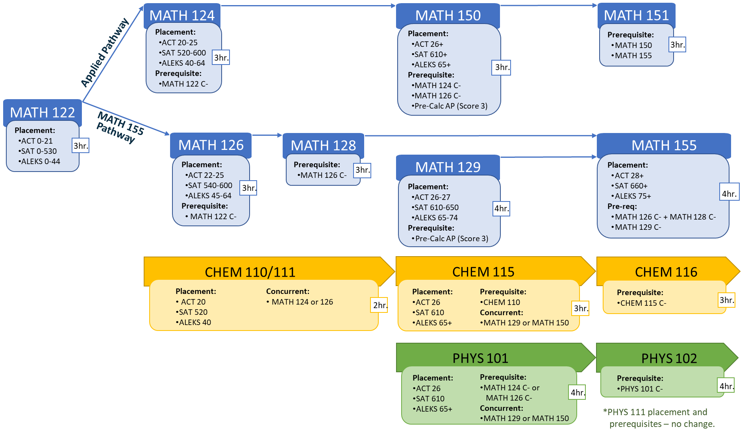
Now, the slightly confusing part…
New Students*:
Current Students**:
*FTF, Transfer Students, and WVU Students with no prior MATH coursework
prior to the 2024-2025 Academic Year.
**Students who have taken a MATH course in affiliation with WVU previously.
Will remain on their current MATH pathway for one semester (the fall 2024 semester).
One Exception: Students who complete MATH 122 before Fall 2024 will no longer need a co-req (MATH 104 or MATH 106).
Example: Students that complete MATH 128 in the spring 2024 semester should take MATH 153 in the fall of 2024.
They may enter CHEM and PHYS under the new guidelines if they have the proper concurrent MATH course.
Enter directly into the entire new STEM Pathway (MATH, CHEM, & PHYS).
= Curricular Innovations

Slide 19
Teaching Out MATH Courses
Fall 2024
Spring 2025
Summer 2025
Fall 2025
MATH 104 and 106 will be taught for the final time in Spring 2024.
Enrolled students notified at start of semester and often afterwards.
Students who need to D/F repeat 153/154, will be provided with a summer session (202405) and two semesters (202408 and 202501).
D/F Repeat Equivalents starting Summer 2025:
MATH 153 -> MATH 129
MATH 154 -> MATH 155
MATH 122
MATH 122
MATH 122
MATH 122
MATH 124
MATH 124
MATH 124
MATH 124
MATH 126
MATH 126
MATH 126
MATH 126
MATH 128
MATH 128
MATH 128
MATH 128
MATH 129
MATH 129
MATH 129
MATH 129
MATH 153
MATH 153
MATH 154
MATH 154
MATH 155
MATH 155
MATH 155
MATH 155
MATH 151
MATH 151
MATH 151
MATH 151

Slide 20
Let’s Break for Questions…
FSC Website: https://stemcollab.wvu.edu/stem-path
Stephanie Young
Stephanie.Young@mail.wvu.edu
Foundational STEM Collaborative
STEMCollab@mail.wvu.edu

