Slide 1
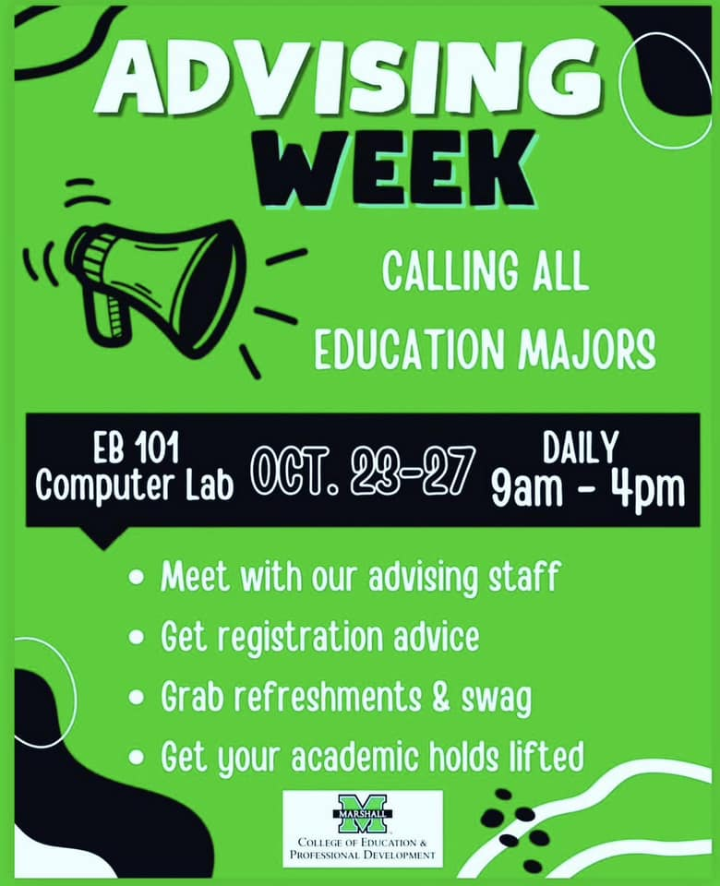
Transformative Shifts in Academic Advising: Utilizing Advising Week
to Cultivate Connection
Welcome to our comprehensive overview of the advising process in the College of Education and Professional Development (COEPD) at Marshall University. This presentation will guide you through our evolving protocols, from pre-COVID to post-pandemic adaptations.
We'll explore the purpose, planning, and positive outcomes of our Advising Week initiative.
Dr. Kandice K. Rowe, Director of SCOPES
Ms. Toni R. Ferguson, Academic Advisor

Slide 2
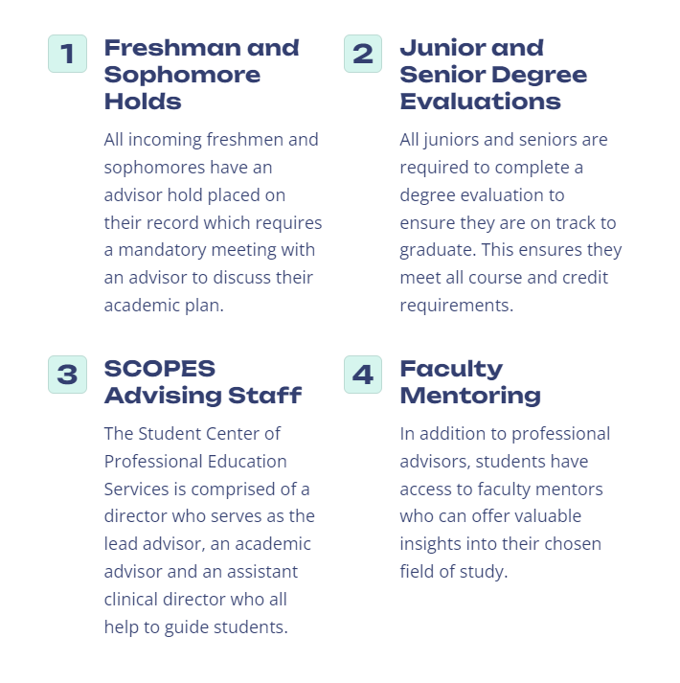
Marshall University College of Education and Professional Development (COEPD) Advising Protocol

Slide 3
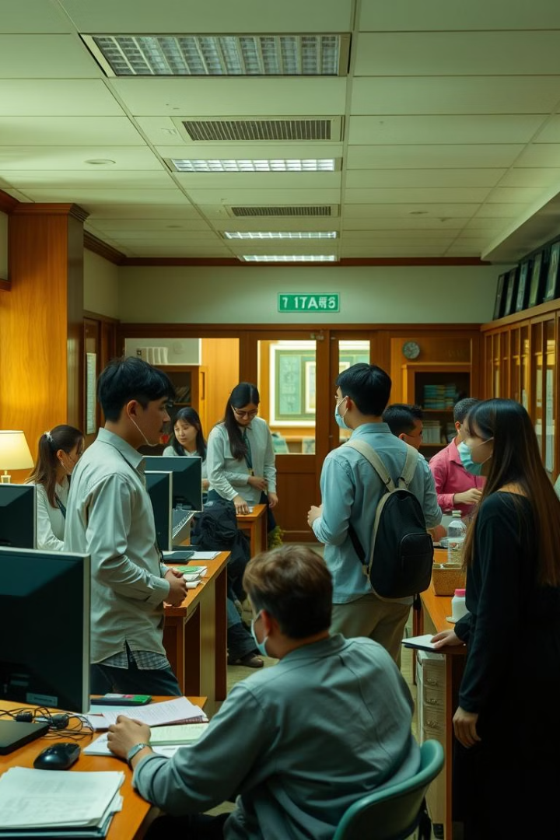
Advising Pre-COVID
1
Traditional, Face-to-Face Advising Model
2
Paper-Based
Systems
Before the pandemic, advising was primarily conducted in-person by a faculty advisor allowing for more personalized interactions and deeper engagement.
Curriculum sheets and four-year plans were hard copy and typically required in person signatures.
3
Limited Flexibility
Students were rarely advised outside of office hours. Often times faculty members posted sign-up sheets outside of their office door to schedule appointments.

Slide 4
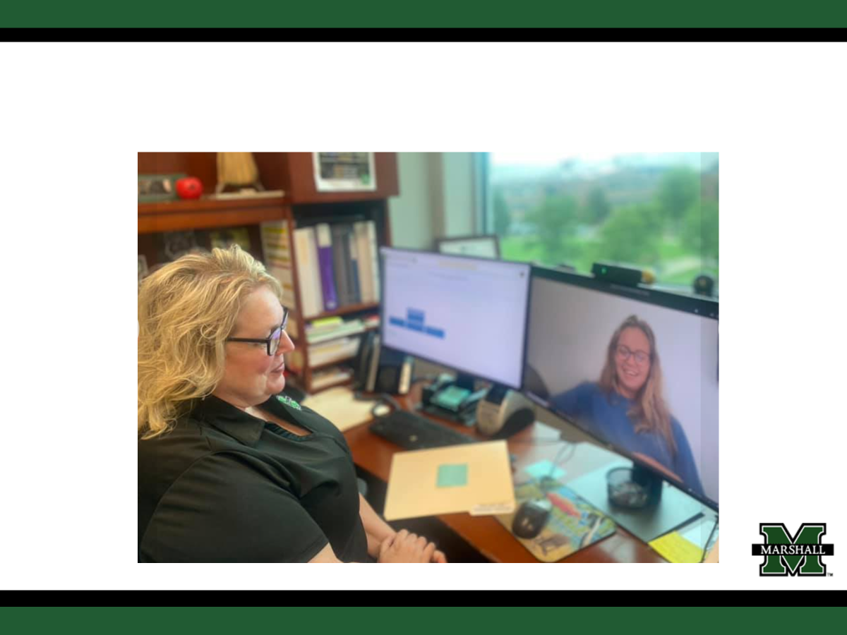
Advising during COVID
Transition to Virtual Advising
The pandemic necessitated a shift to virtual advising, utilizing platforms like Zoom, TEAMS, email and other online tools.
Adapting to New Technologies
Students, faculty, and advisors had to adapt to using online tools for communication and meetings, ensuring seamless interaction and information sharing.
Challenges and Opportunities
While virtual advising presented challenges, it also opened new avenues for accessibility and flexibility, allowing for more convenient interactions. For clarity and consistency, all advisees in the COEPD were transferred to one academic advisor eliminating the faculty advisor.

Slide 5
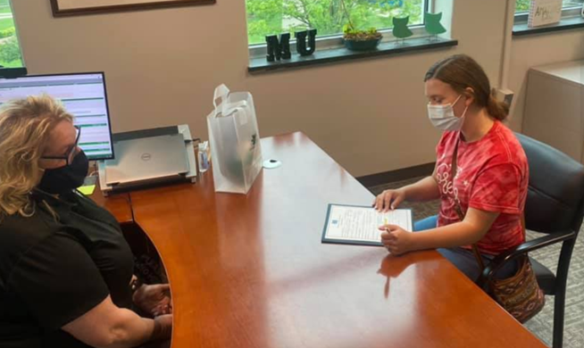
Advising Post-COVID
Hybrid Model
Enhanced Technology
The COEPD adopted a hybrid approach to advising, incorporating both in-person and virtual options to cater to student needs.
Continued use of digital tools to streamline processes and improve accessibility.
Personalized Approach
We combined the best of professional advising with faculty mentoring to increase personal touch with pandemic-era students.

Slide 6
Today’s COEPD Advising Protocol
1
Initial Contact
Students are assigned an academic advisor and faculty mentor at freshmen orientation or when they officially declare their major.
2
Scheduling
Students meet with advisors as needed during the semester via appointments or walk-ins. Advising for the upcoming semester is completed during "Advising Week".
3
Preparation
Students are emailed their advising responsilbiites and are encouraged to complete these prior to attending "Advising Week".
4
Consultation
Advisor and student meet in person to discuss semester progress, academic challenges, and scheduling plans for the future.

Slide 7
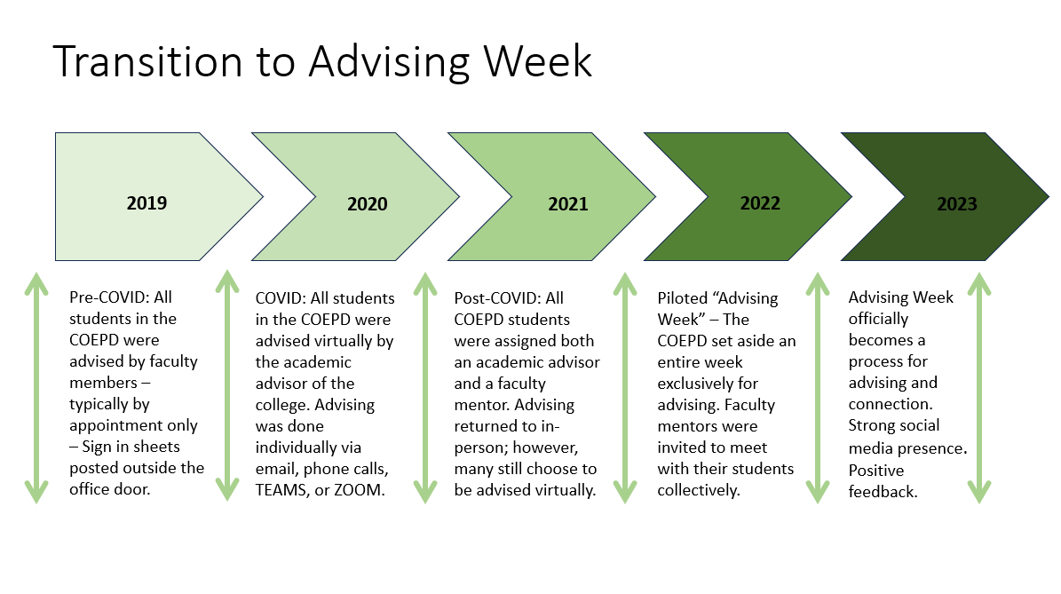
Professional Advisor N=1
Professional Advisor N=1
Professional Advisor N=1
Professional Advisor N=2
Professional Advisor N=2

Slide 8
Planning of Advising Week
Timeline
Task
Responsible Party
3 Months Prior
Set dates and goals
SCOPES Office
2 Months Prior
Coordinate with departments
Department Heads
1 Month Prior
Prepare materials and schedules
SCOPES Office
2 Weeks Prior
Promote event to students
Email, flyers and social media outlets
During Week
Execute advising sessions
SCOPES Office, faculty and staff

Slide 9
What We Learned and How it Can be Implemented for you - Post-Pilot Fall 2022: N = 297
We MUST have a front desk person (GA, student, faculty, staff) working instead of a sign-in sheet
We MUST have printed copies of Advising Agreements
We MUST have an earlier start time to avoid staying late
We MUST have a designated lunchtime
We MUST have stickers, snacks, and social media contests
We MUST have a better process to keep data

Slide 10
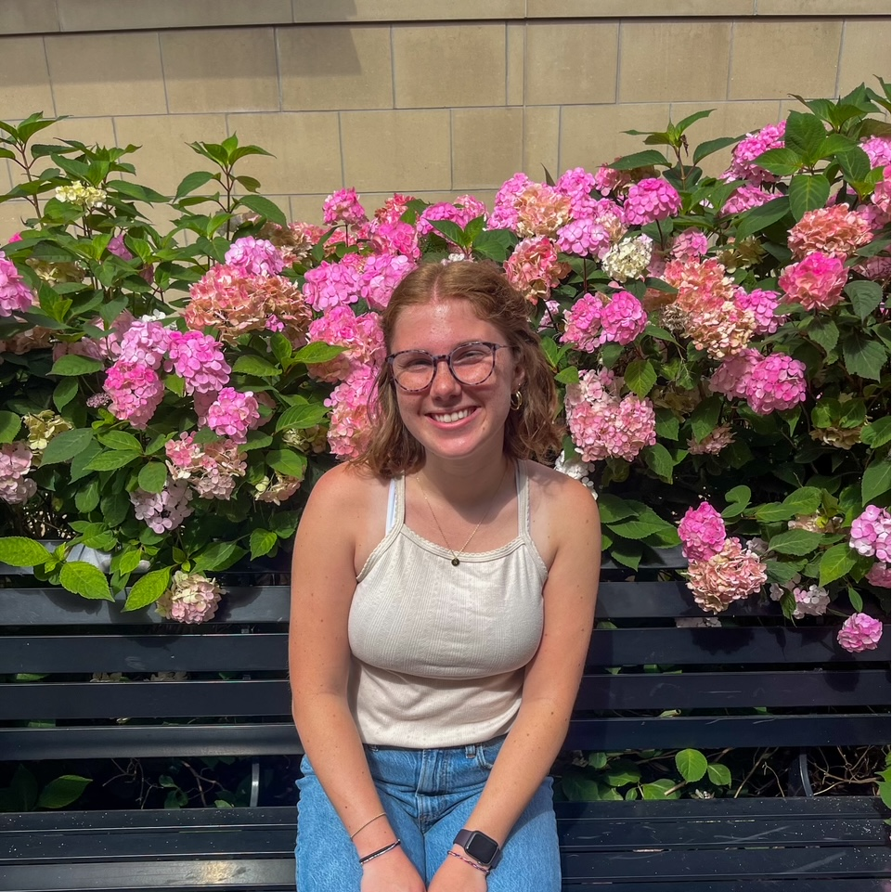
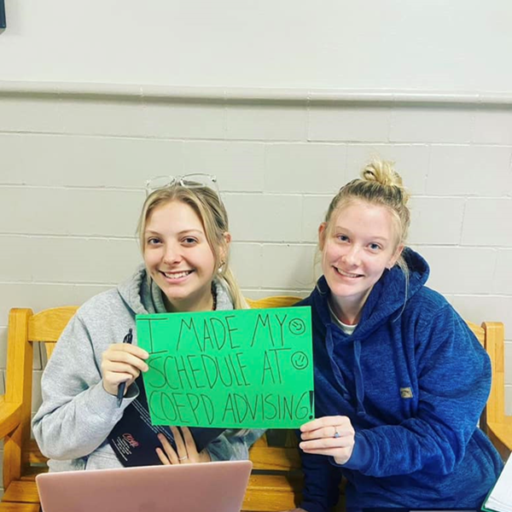
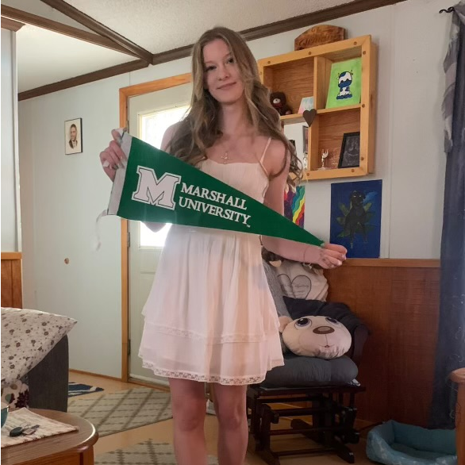
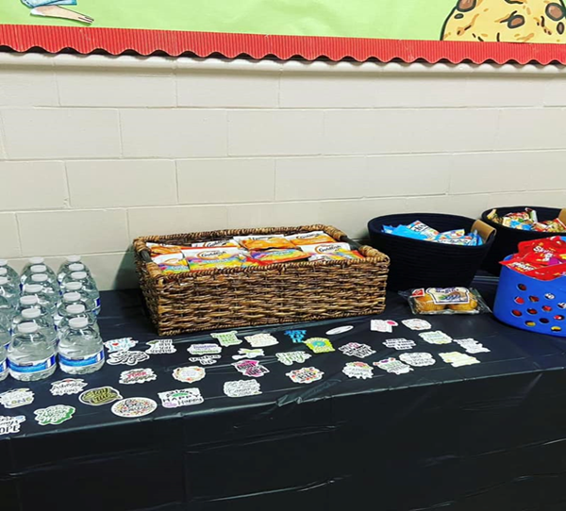
Positive Feedback from Students
“If Advising Week was held by appointment with the amount of students there are, I think it would be way more work and more chaotic”
“I like Advising Week because it is organized and I can come when it works best for me during a set week”
“I like how we actually have an Advising Week unlike other colleges. I like having stickers and snacks”
“I like catching up with my advisor”

Slide 11
College (COEPD) Data
Semester | Students Advised
Fall 2022 (Pilot) | 297
Spring 2023 | 249
Fall 2023 | 310
Spring 2024 | 214

Slide 12
Institutional Data
*Data provided by Marshall University Academic Affairs and Institutional Research

Slide 13
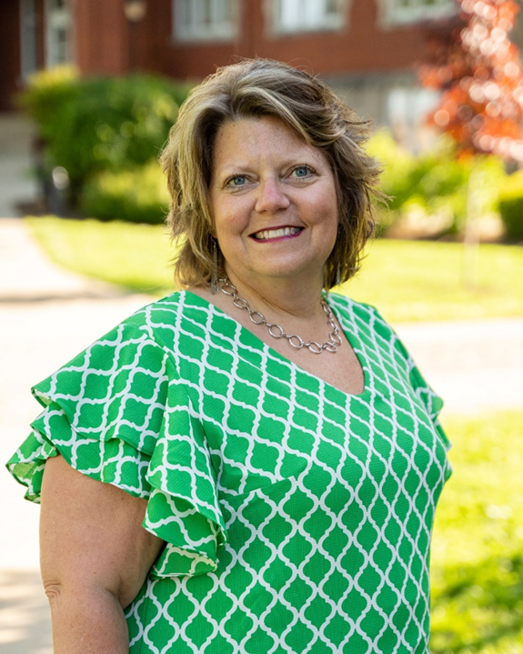
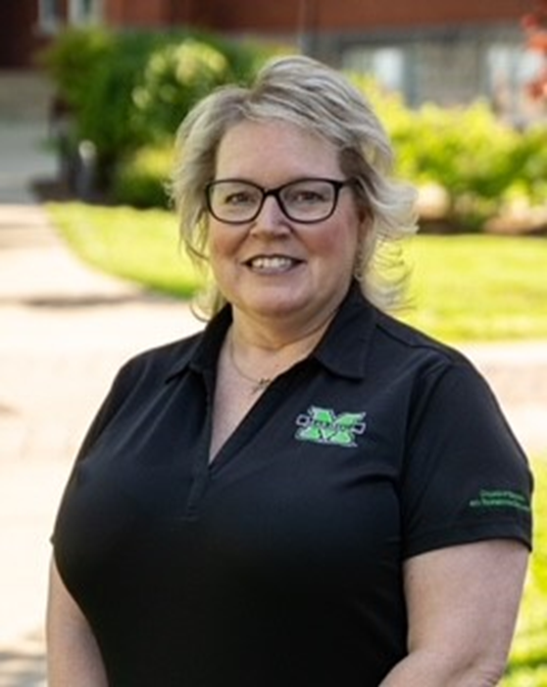
Thank you!
Questions?
Ms. Toni Ferguson is an Academic Advisor at Marshall University, where she specializes in guiding students within the College of Education and Professional Development. Additionally, she is a certified appreciative adviser through Florida Atlantic University, holding a lifetime designation
Dr. Kandice Rowe serves as the Lead Advisor and Director of the Student Center of Professional Education Services in the College of Education and Professional Development at Marshall University. With a distinguished career spanning nearly 24 years at Marshall, Dr. Rowe brings over two decades of expertise in academic advising to her role. Her contributions to the field have been recognized with the NACADA Region 3 Excellence in Advising Award in 2019.
Ms. Toni Ferguson
Marshall University
College of Education and Professional Development
Academic Advisor
fergusont@marshall.edu
(304) 696-2861
Dr. Kandice Rowe
Marshall University
College of Education and Professional Development
Director of SCOPES
Kandice.napier@marshall.edu
(304) 696-6842

